Slide 1


History & Practical Applications of GRS/GCS Structures
Nate Beard, P.E.
Matt Reihl, P.E.

Slide 2

HISTORY

Slide 3
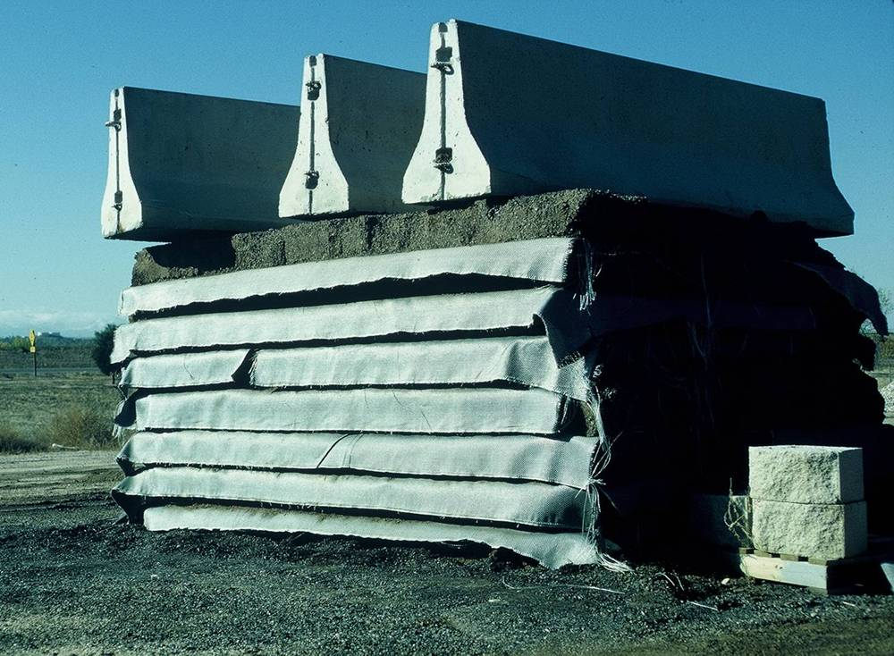
What is GRS or GCS?
Geosynthetically Reinforced Soil (GRS)
Geosynthetically Confined Soil (GCS)
An engineered fill of closely spaced alternating layers of compacted granular fill.

Slide 4
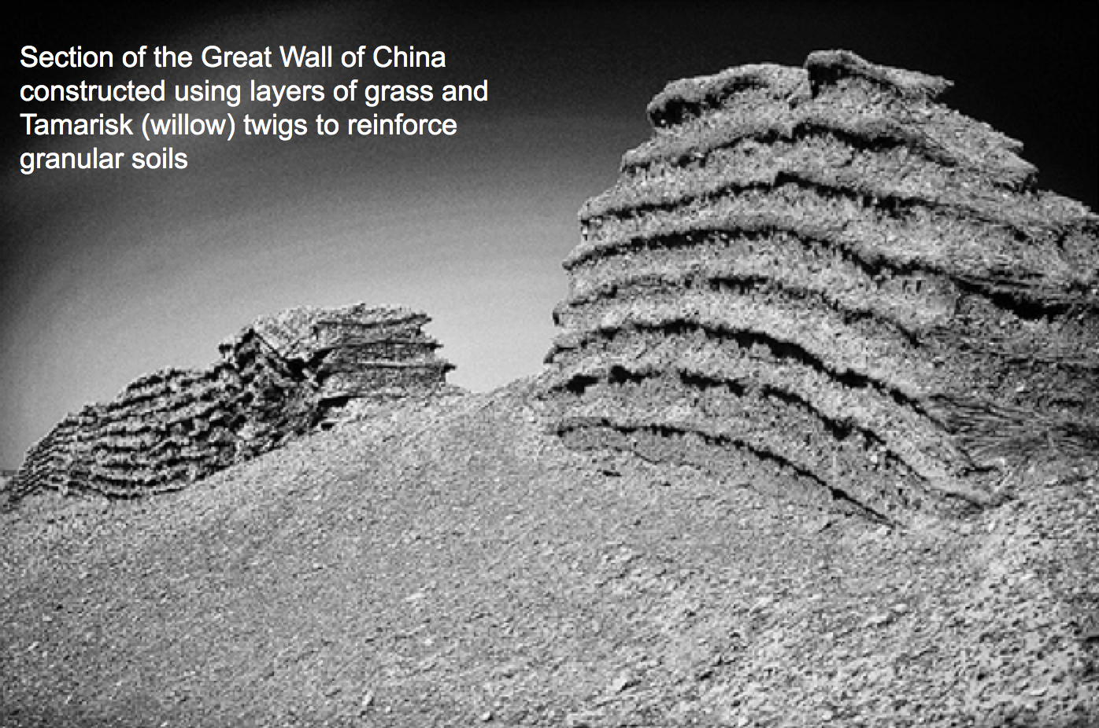
HISTORICAL USE OF REINFORCED SOIL (200 BC)
Section of the Great Wall of China constructed using layers of grass and Tamarisk (willow) twigs to reinforce granular soils

Slide 5
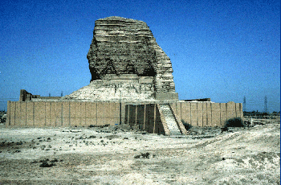
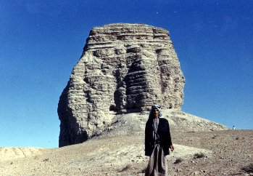
ziggurats 1440 BC
Soil Reinforcement is a Very Old and Proven Technology

Slide 6
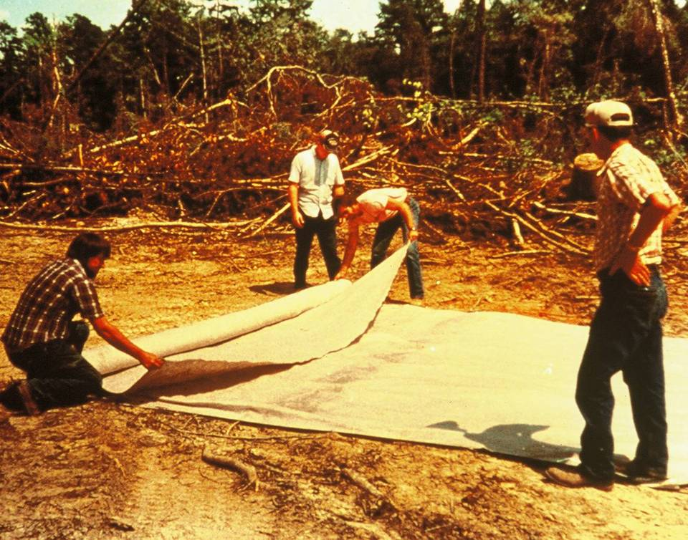
U.S. FOREST SERVICE
First use of geosynthetics to stabilize logging roads

Slide 7
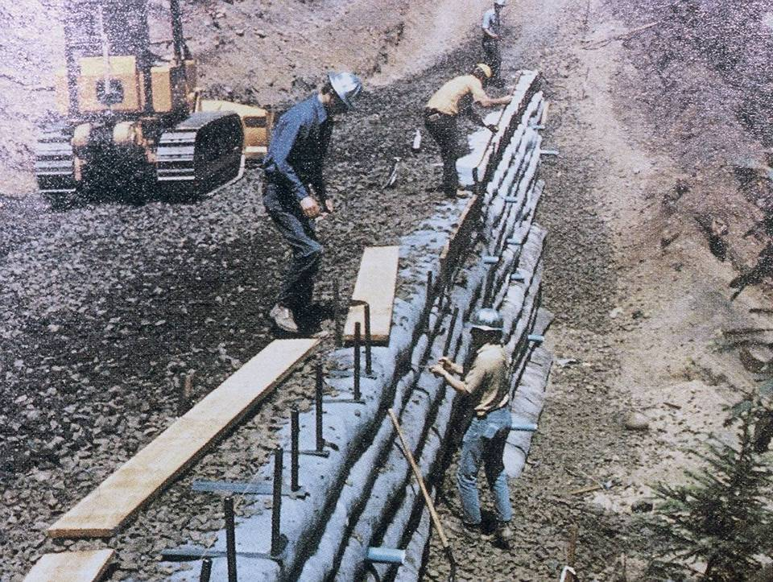
U.S. FOREST SERVICE – FIRST USA FABRIC WALL

Slide 8
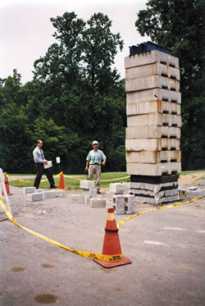
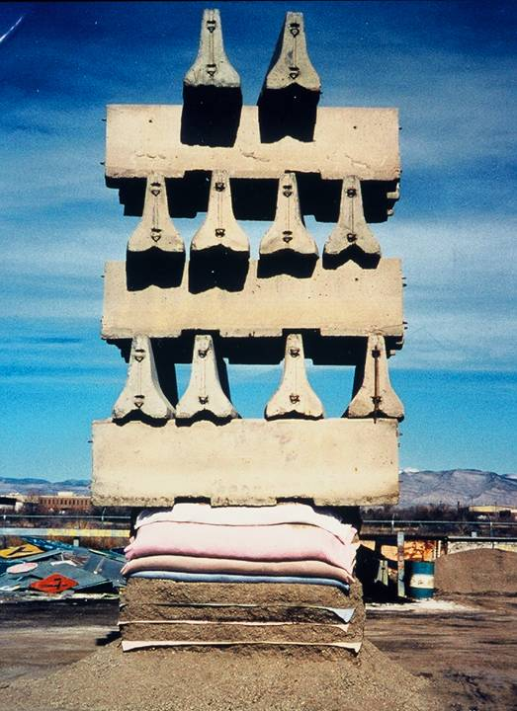
TESTING
Cheesecloth reinforced soil (CRS) structure supporting 10 tons.
Test without cloth failed when second block was placed.
“Bedsheet” Reinforced Soil (BRS)

Slide 9
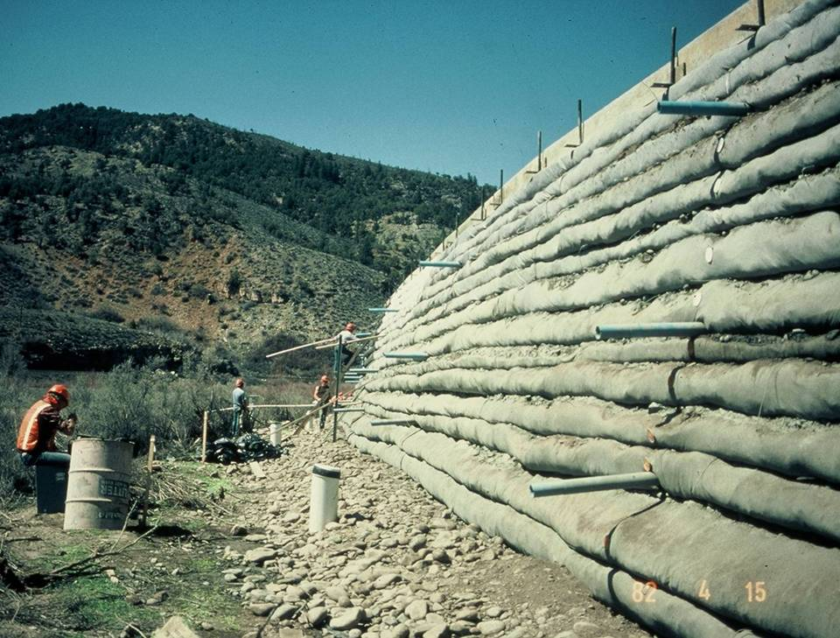
RESEARCH
Largest GCS Research Wall, 1982

Slide 10
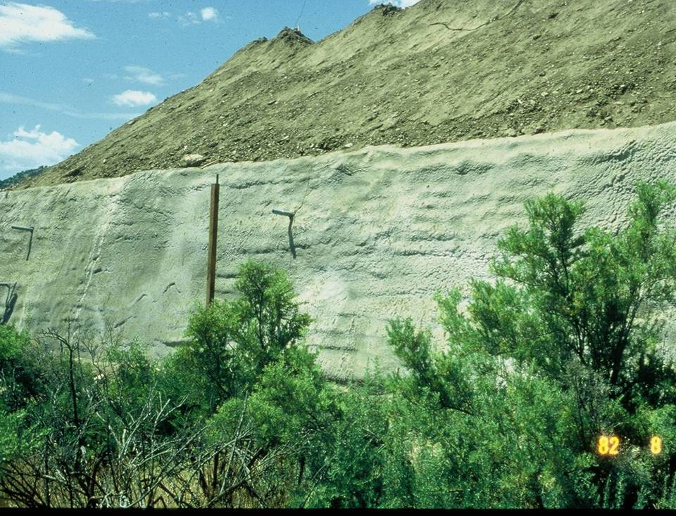
RESEARCH
Calculated Factor of Safety of 0.1
AASHTO applies to MSE not GRS

Slide 11
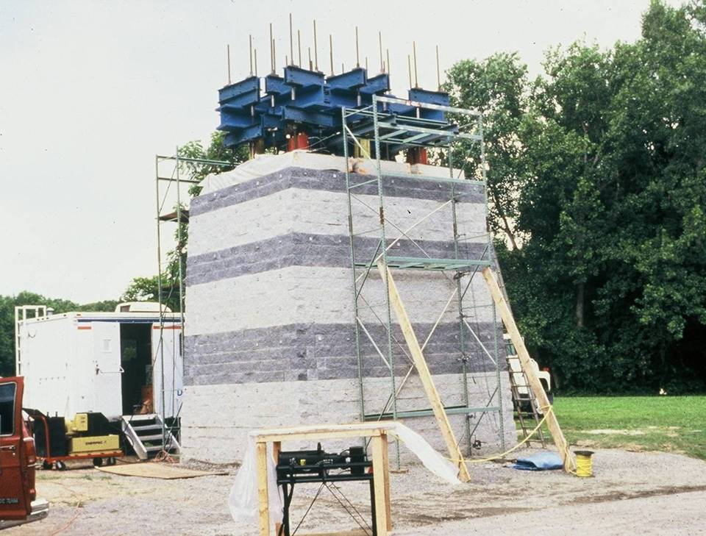
FHWA Research center
GCS Bridge Pier exceeded 10 tons per square foot bearing capacity.

Slide 12
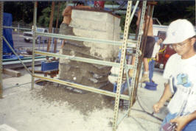
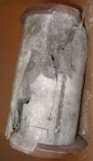
Composite failure
FHWA Mini-Pier Experiment
Photo courtesy of M. Adams

Slide 13

Comparison between GRS/GCS and MSE
GCS™
Composite Structure
Internally stable
Friction Connections
Lightweight Inclusions
Close spacing
High Safety Factor
MSE
Reinforced Soil Structure
Quasi-tieback
Pin Connections
Strong reinforcement
Wide Spacing
2-10% Failure Rate

Slide 14
Reinforcement spacing
Composite
Tie-back
GRS
MSE
4” 8” 12” 16” 20” 24” 28” 32”
S_{v} =
B/H ≥ 0.3
B/H ≥ 0.7
H
B
B
Notes:
Zone of influence
The “grey” area has not been fully defined yet; it is a function of soil properties, reinforcement type, and degree of compaction

Slide 15
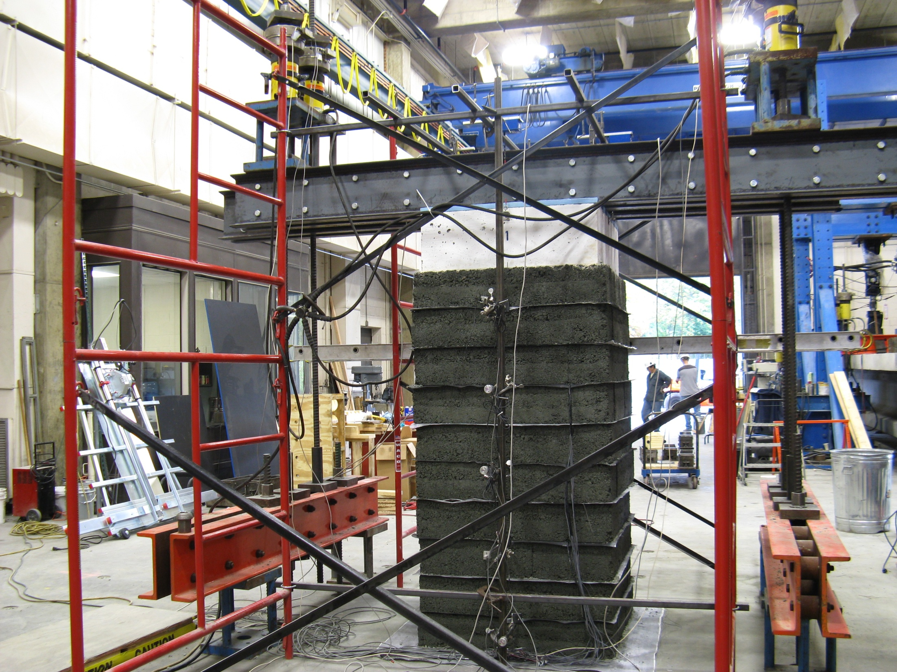
0.5 ksf
(25 kPa)

Slide 16
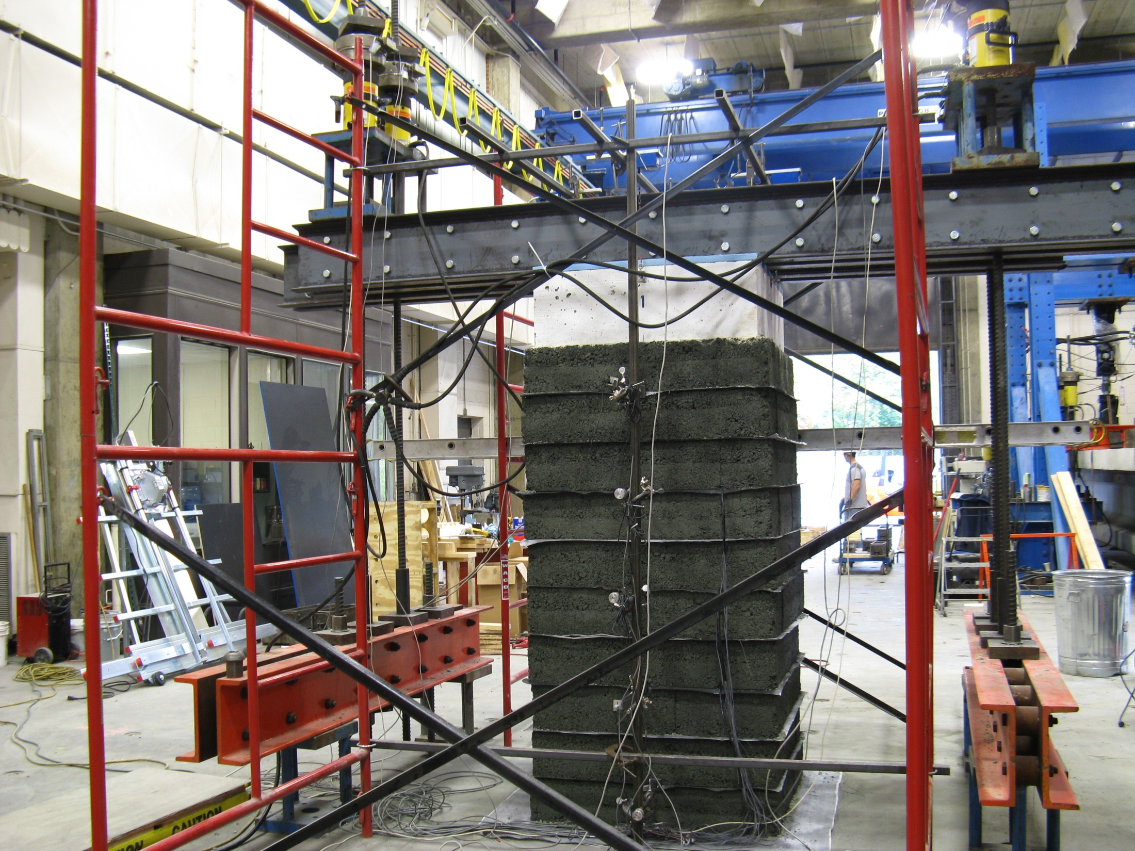
4.1 ksf
(196 kPa)

Slide 17
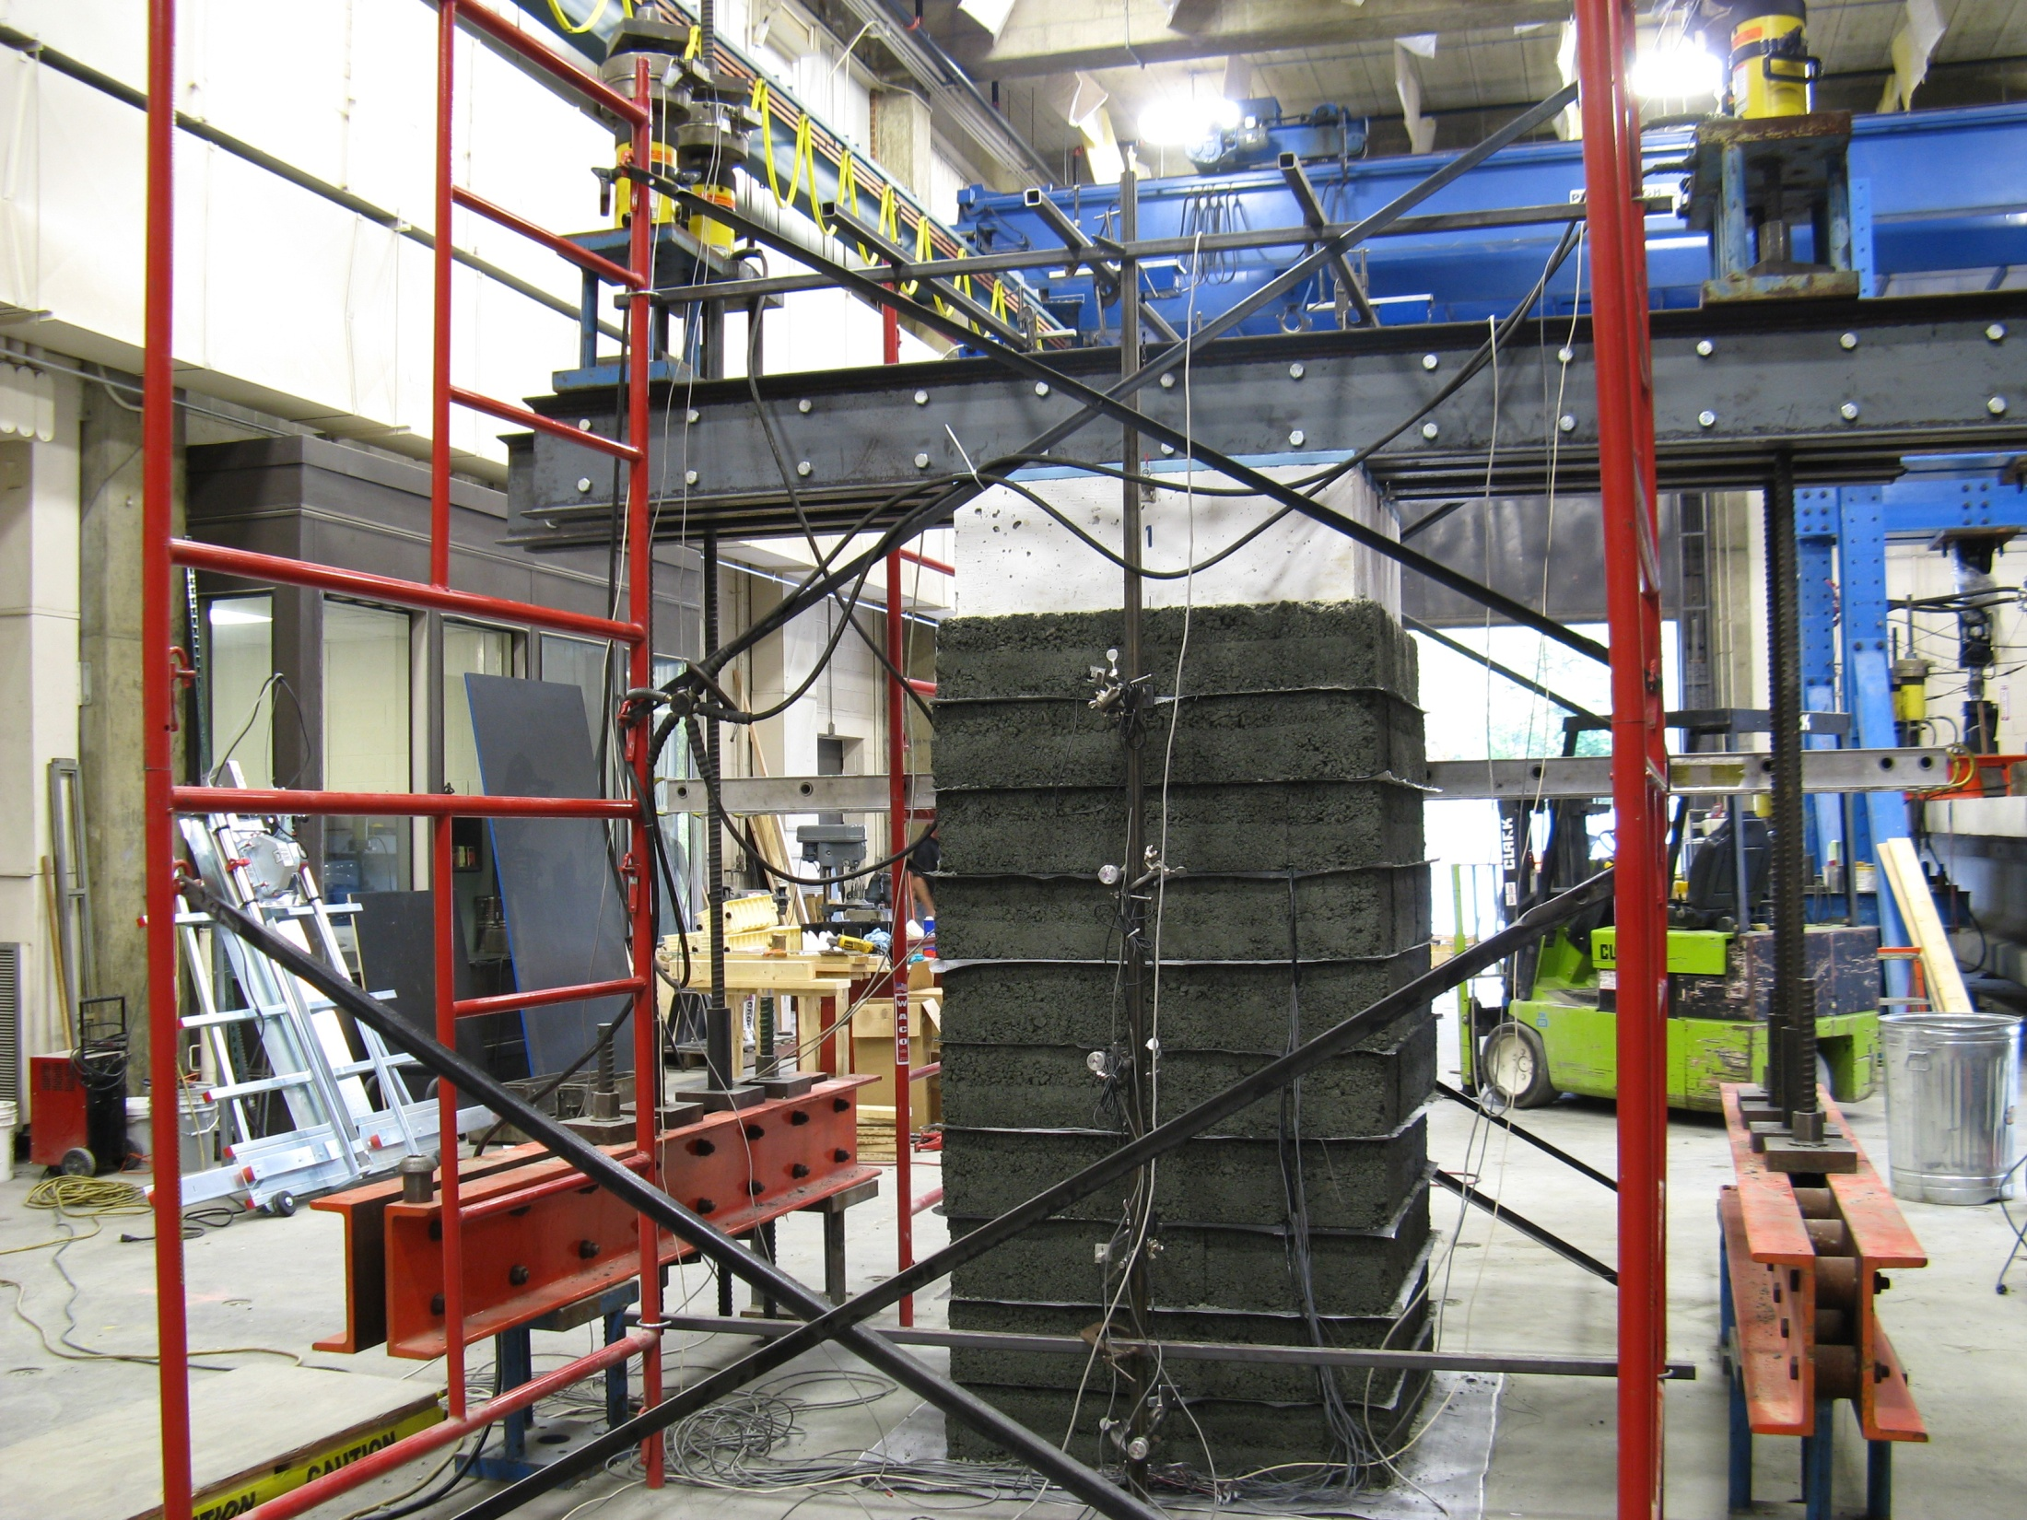
5.9 ksf
(282 kPa)

Slide 18
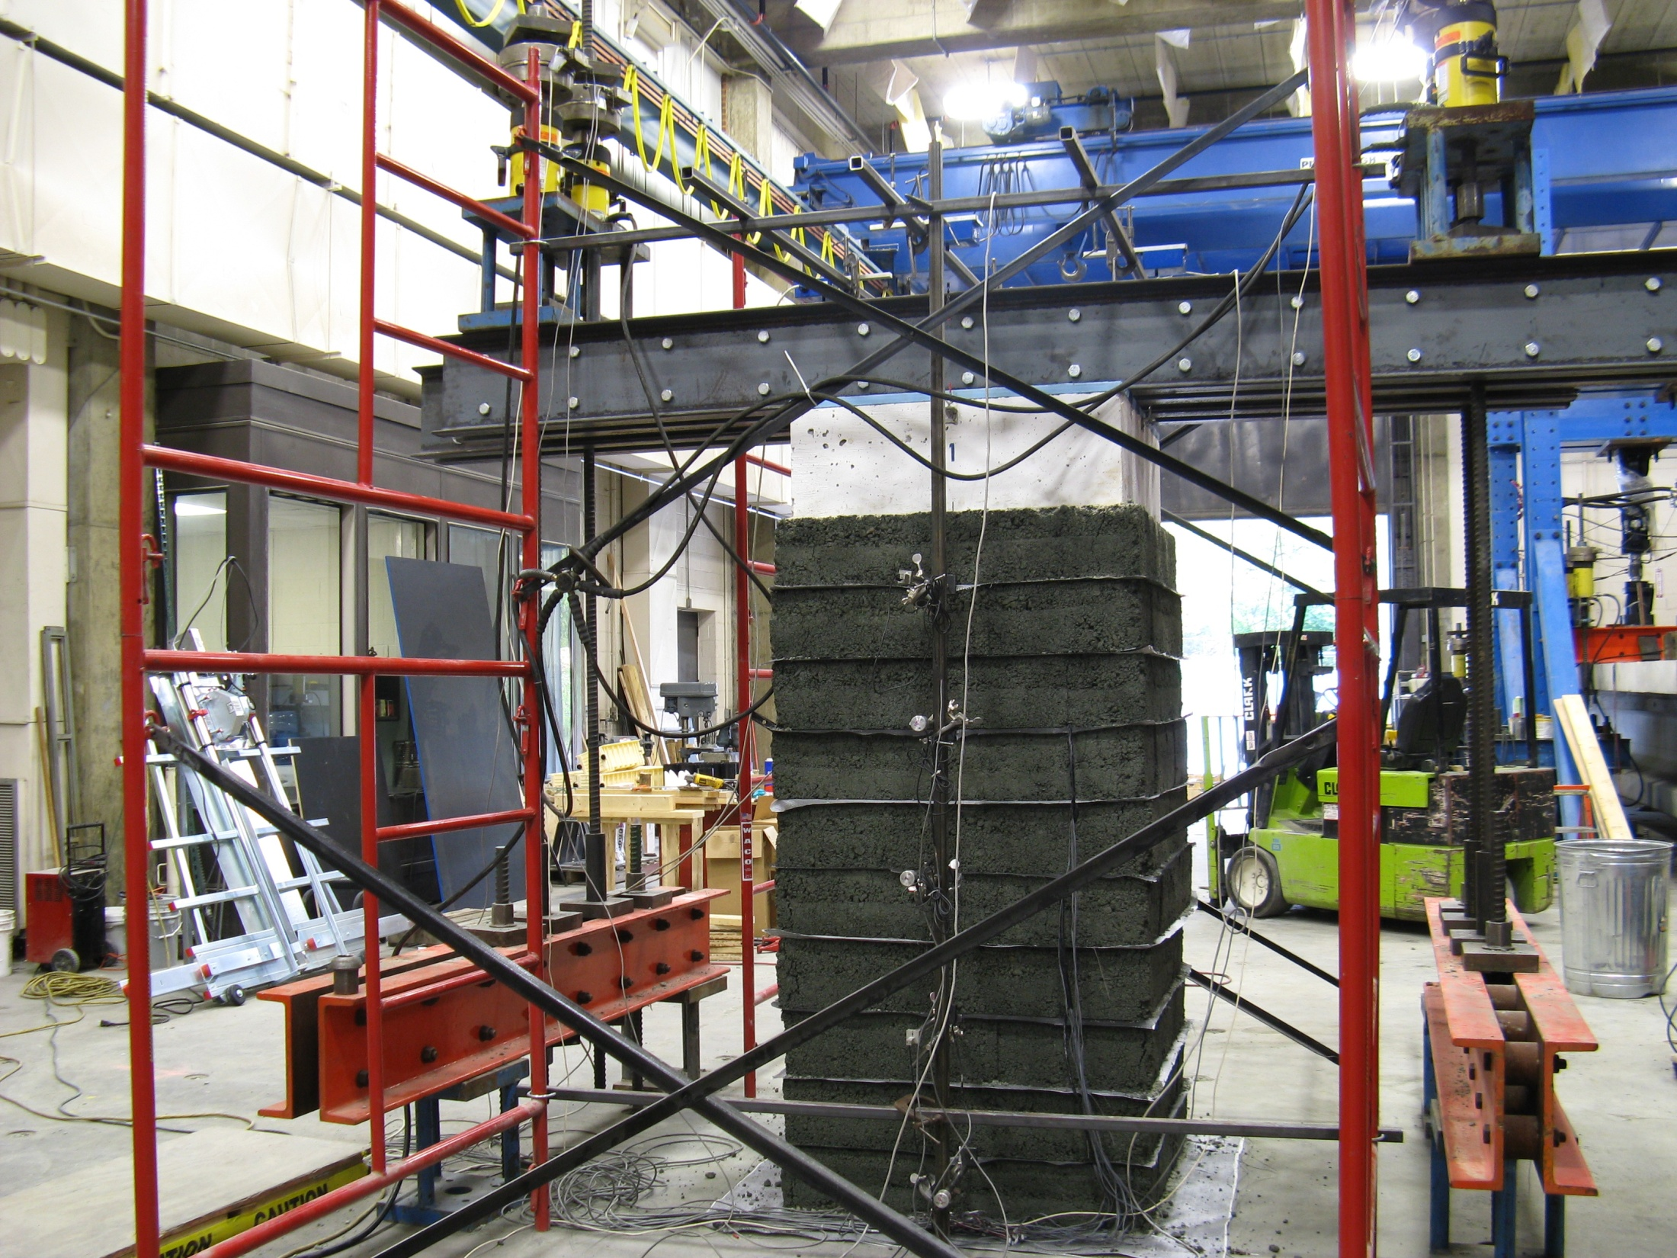
8.5 ksf
(407 kPa)

Slide 19
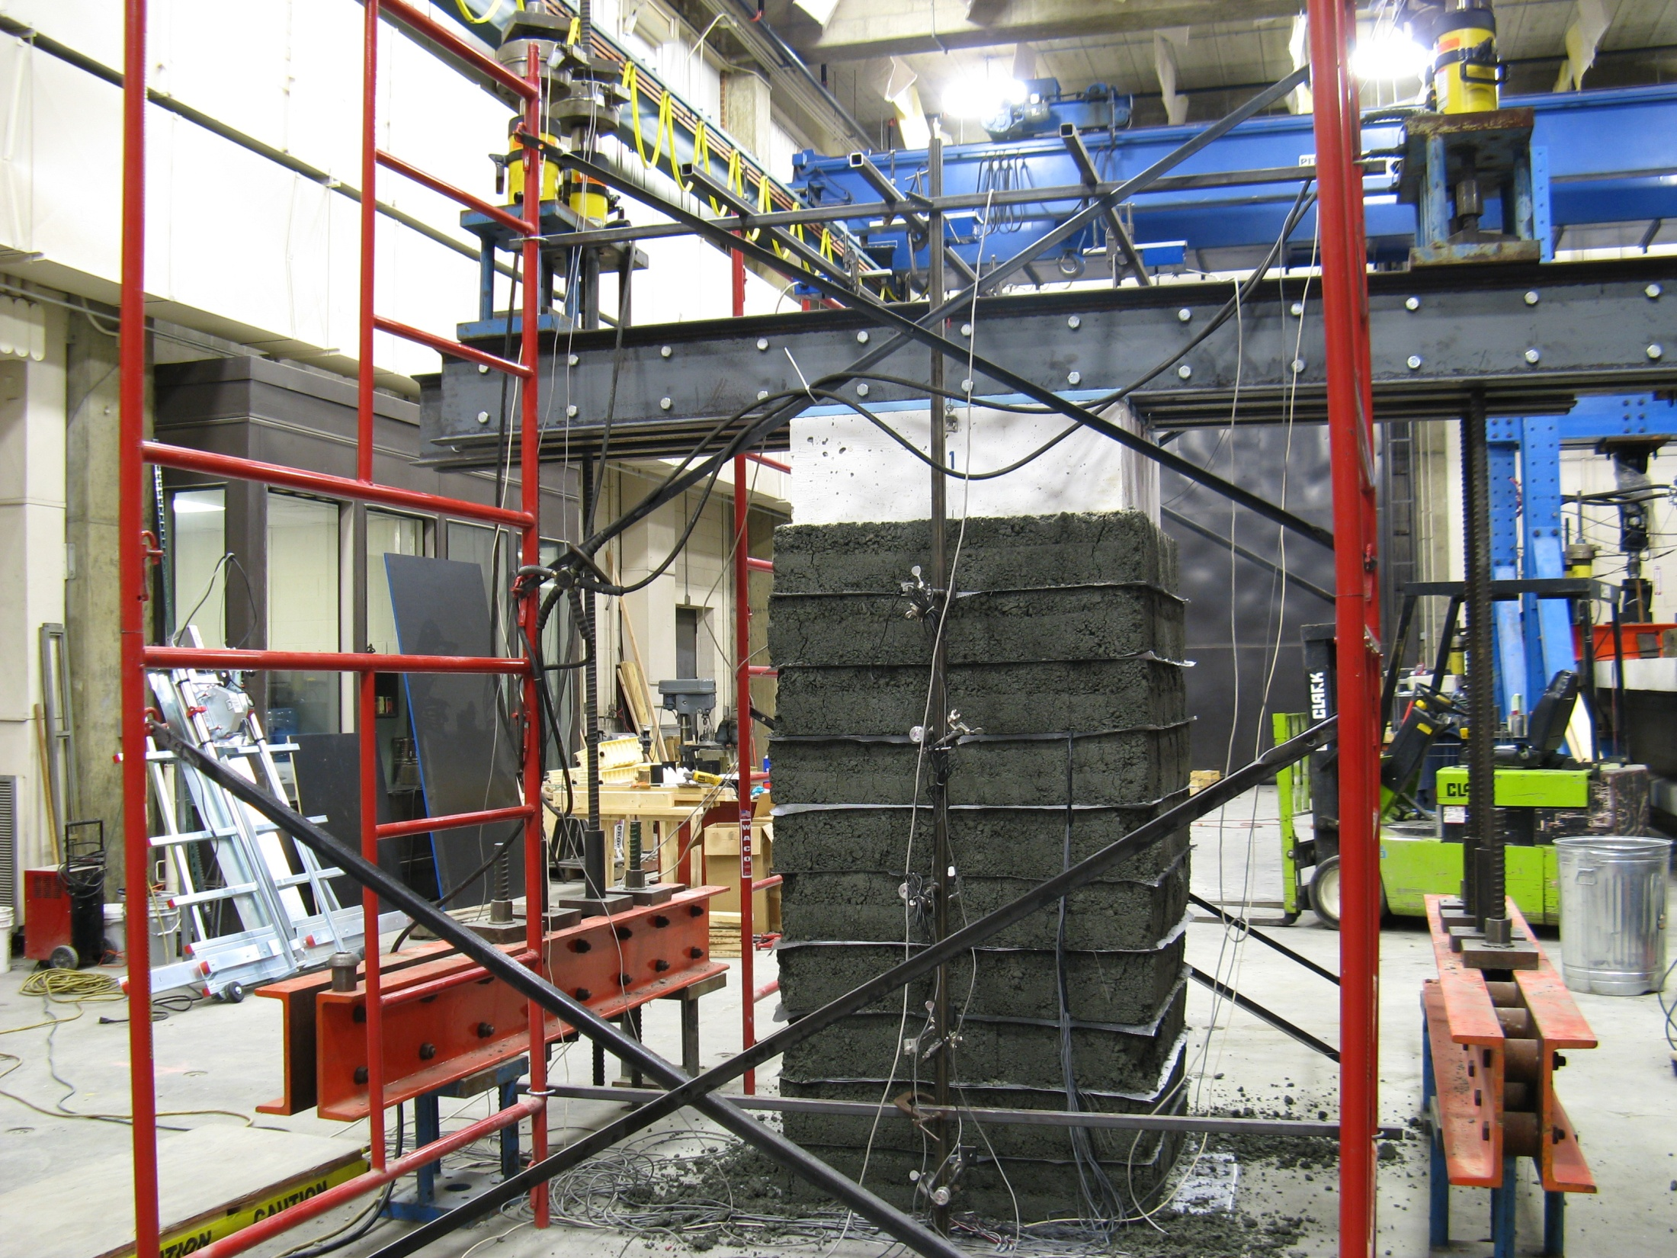
11.3 ksf
(541 kPa)

Slide 20
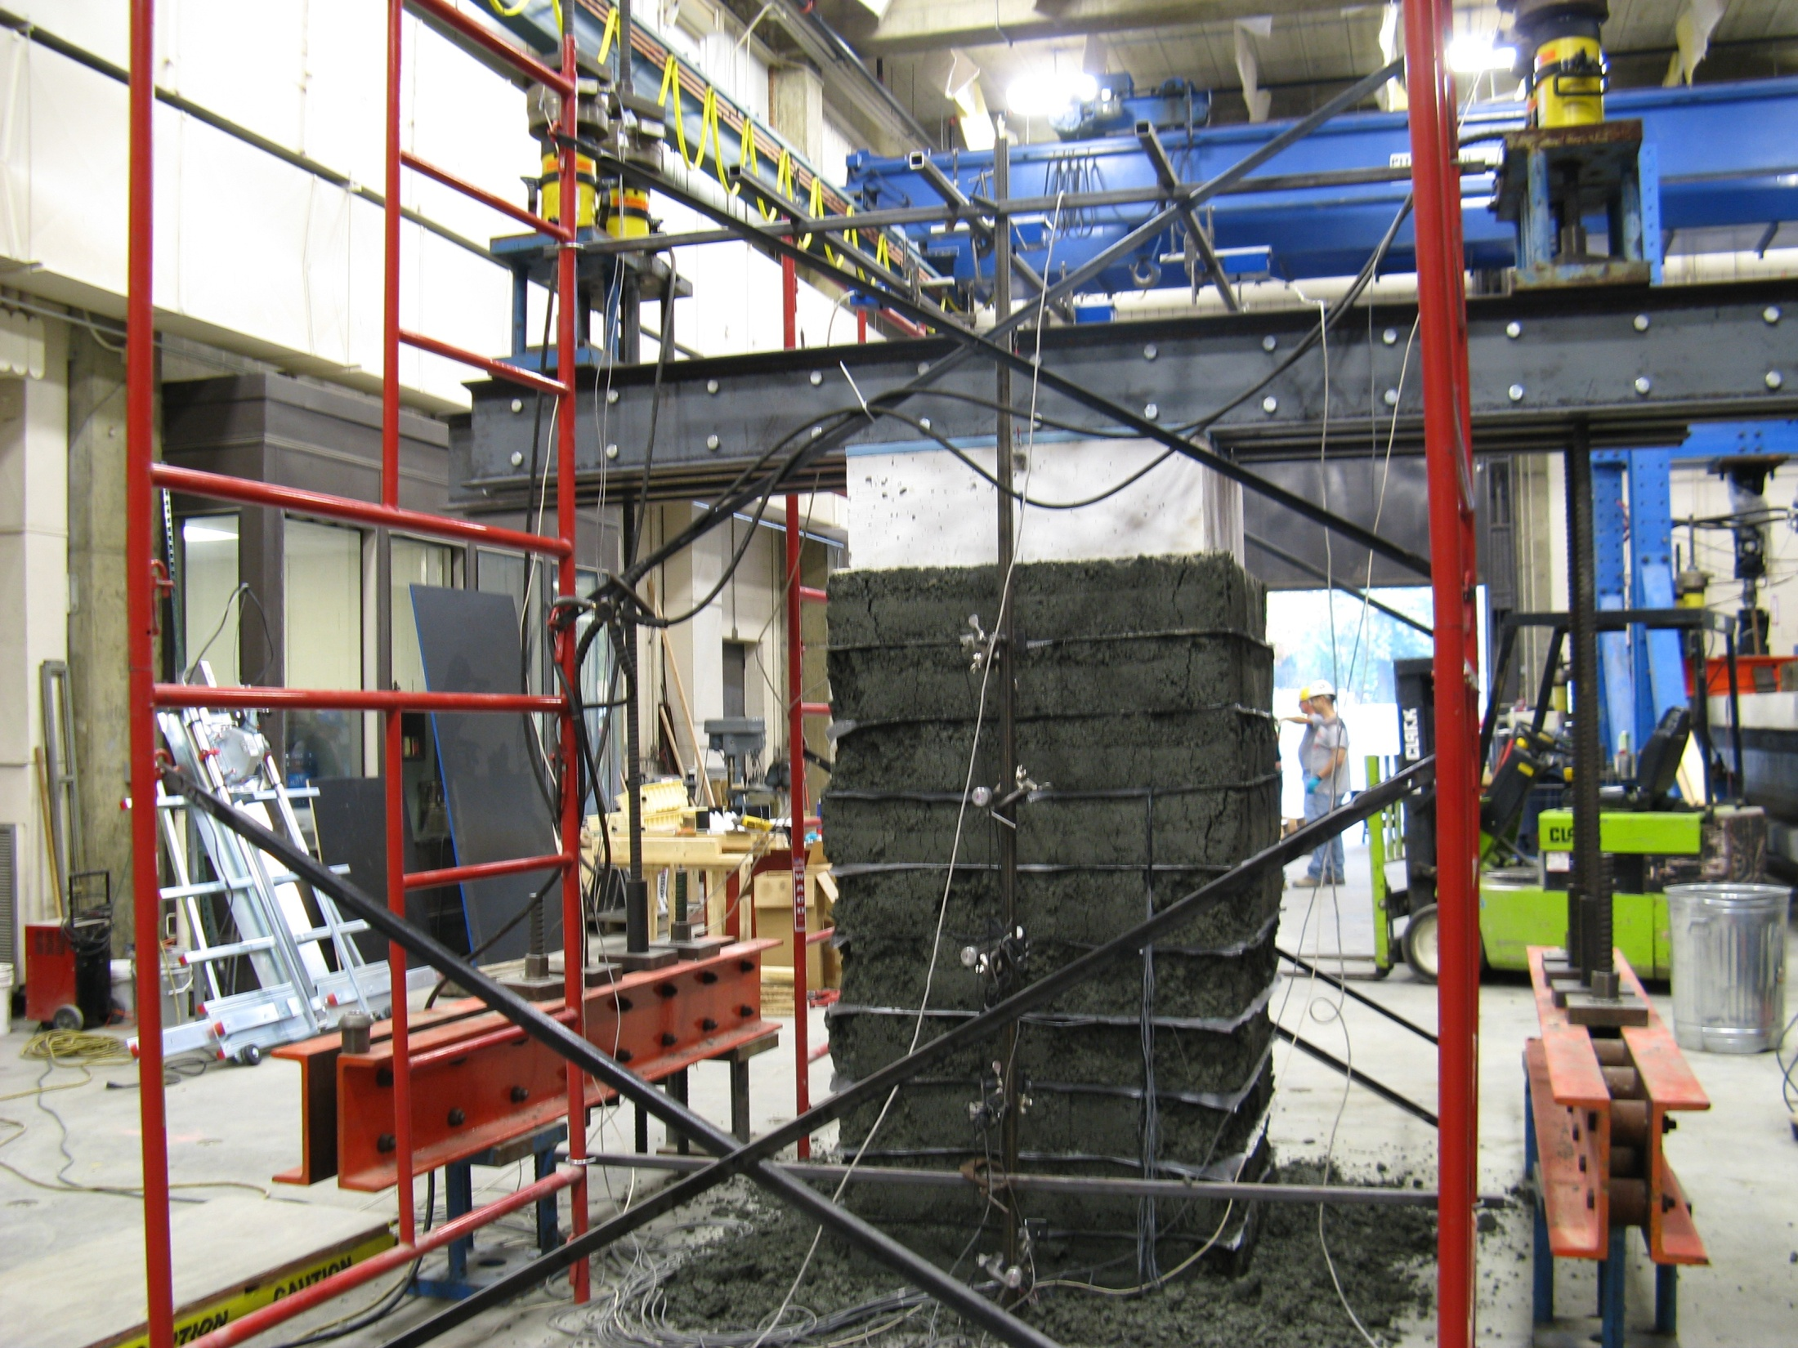
15.3 ksf
(733 kPa)

Slide 21
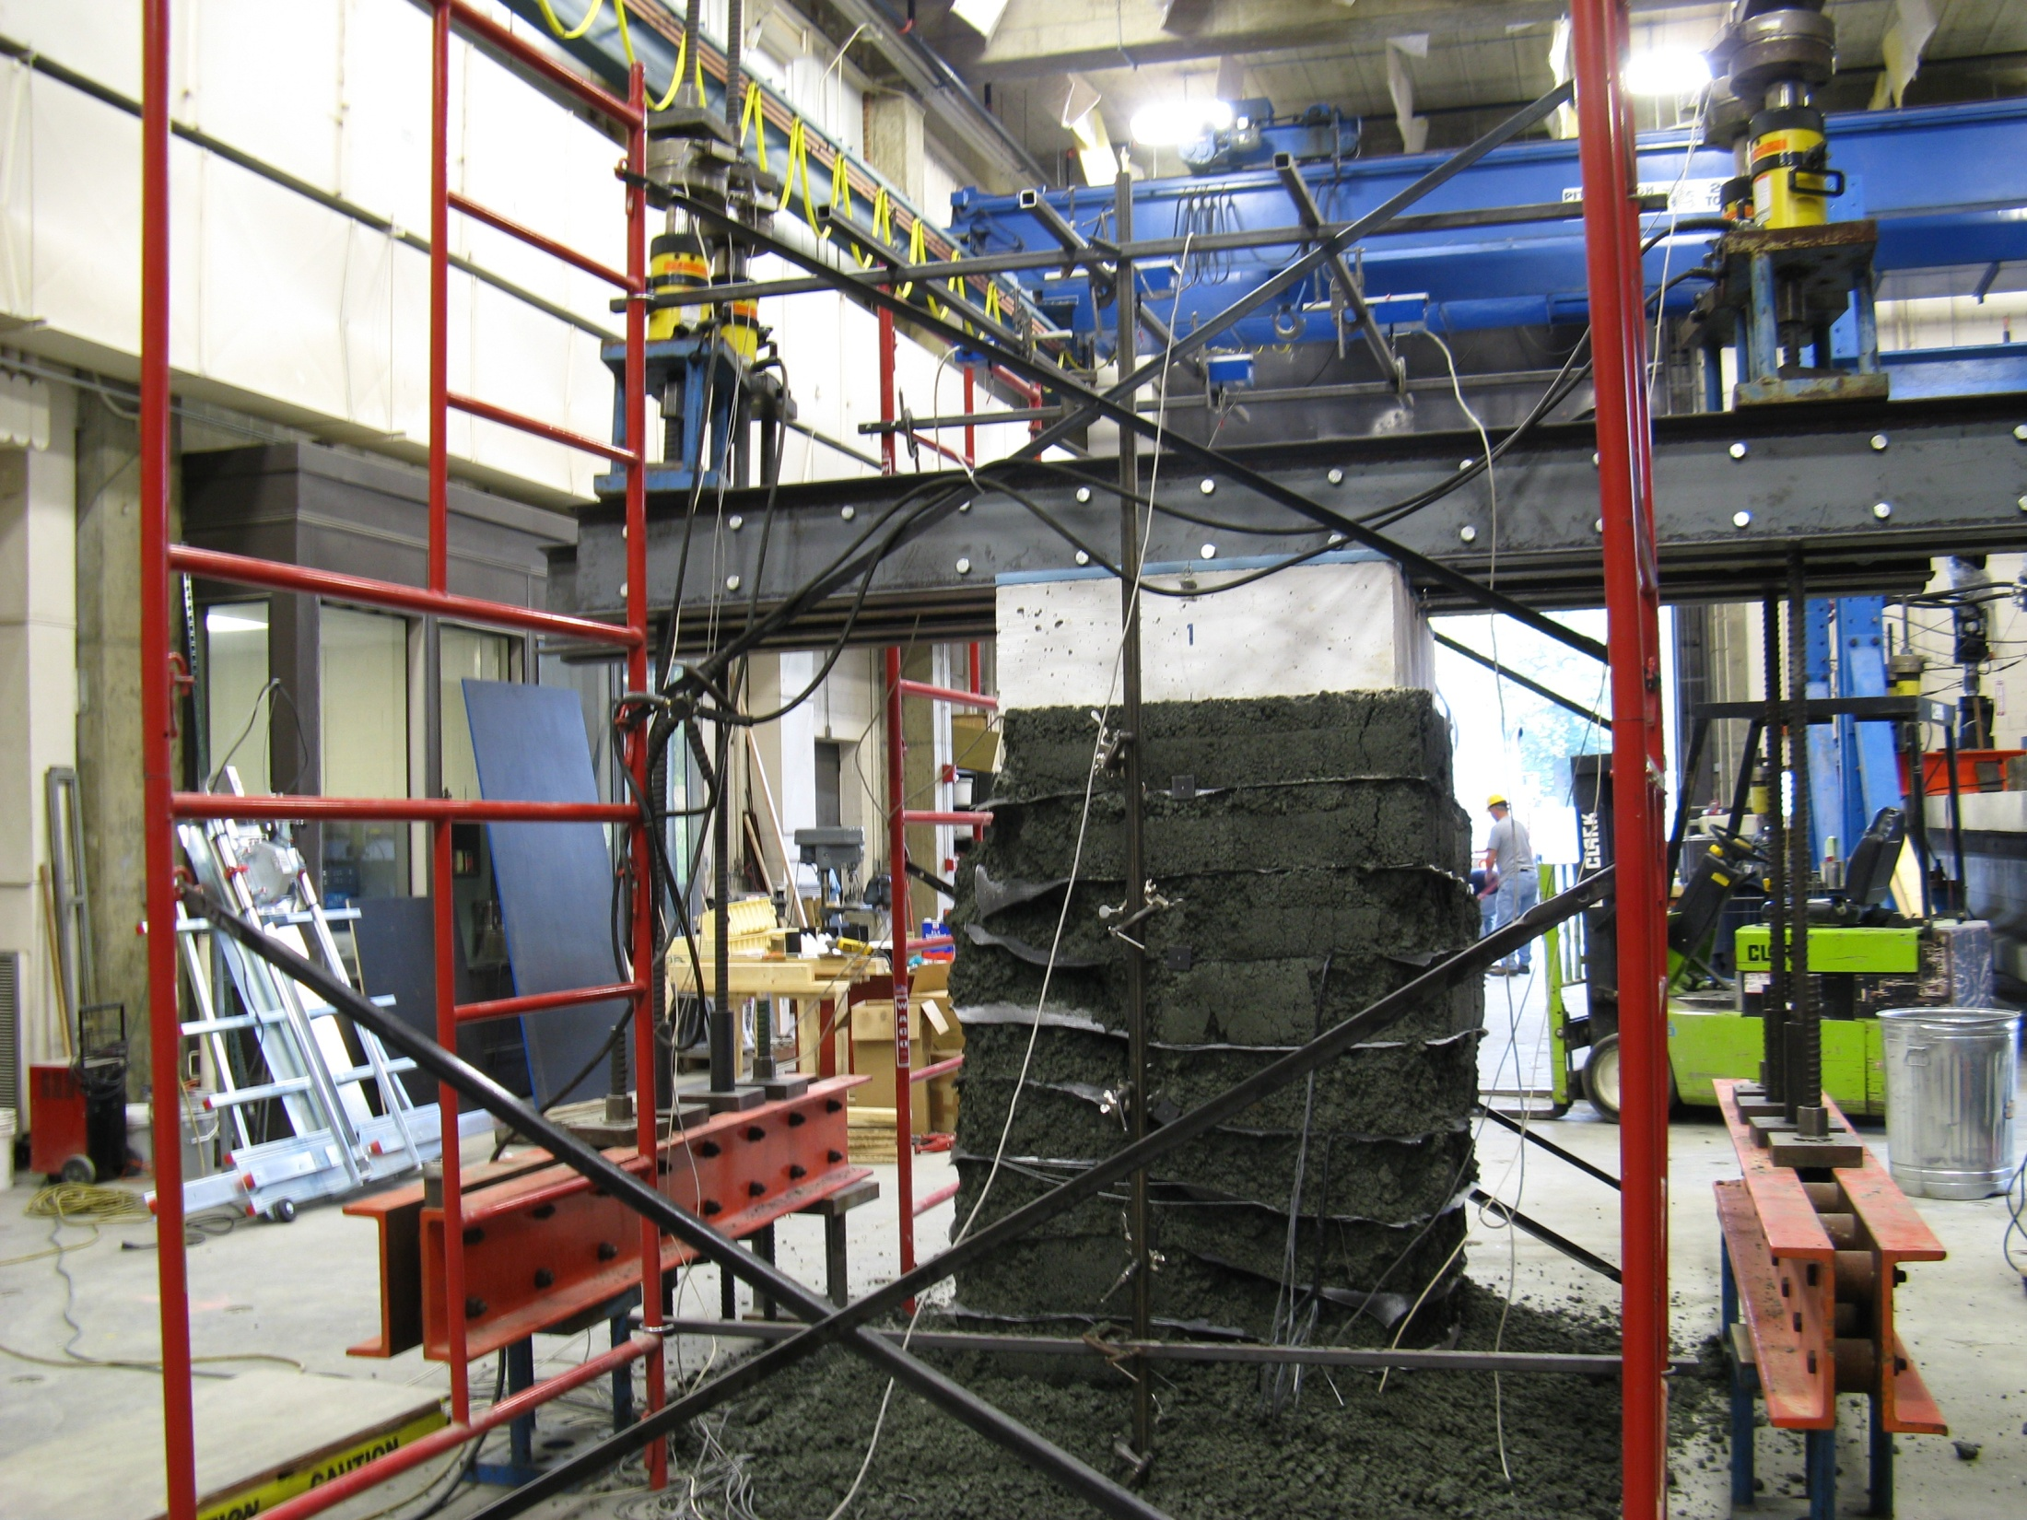
18.1 ksf
(867 kPa)

Slide 22


2400 lb/ft @ 8” Spacing, No CMU Facing, <0.5% strain
18,000 lb/ft shown in Post-Picture
Performance test
Pre-
Post-

Slide 23
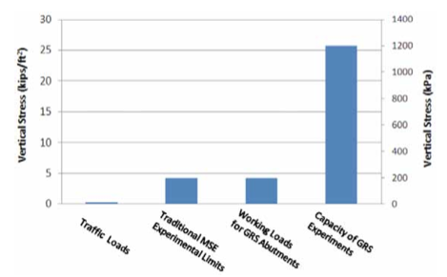

Slide 24
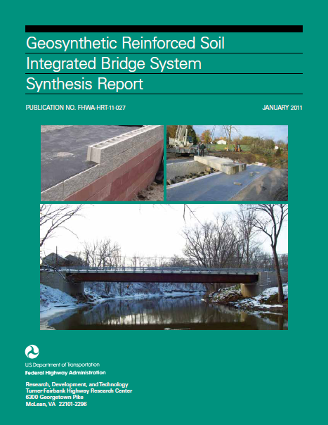

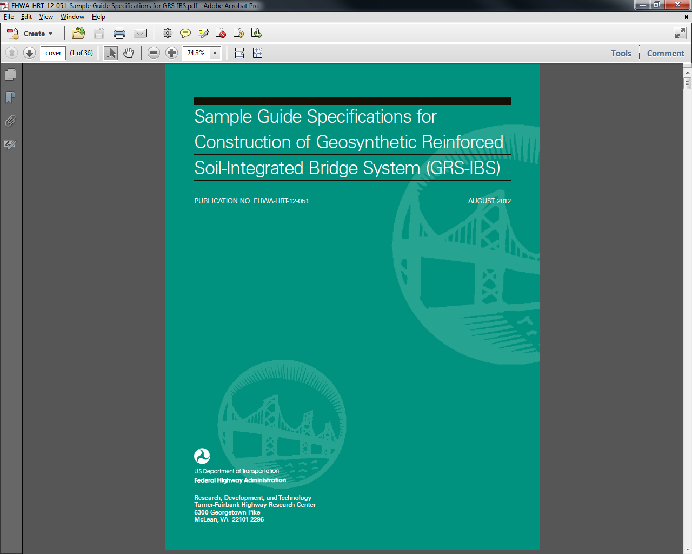
Reference materials
Sample Guide
The Science
(Research)
Application
(Engineering)

Slide 25
APPLICATION

Slide 26
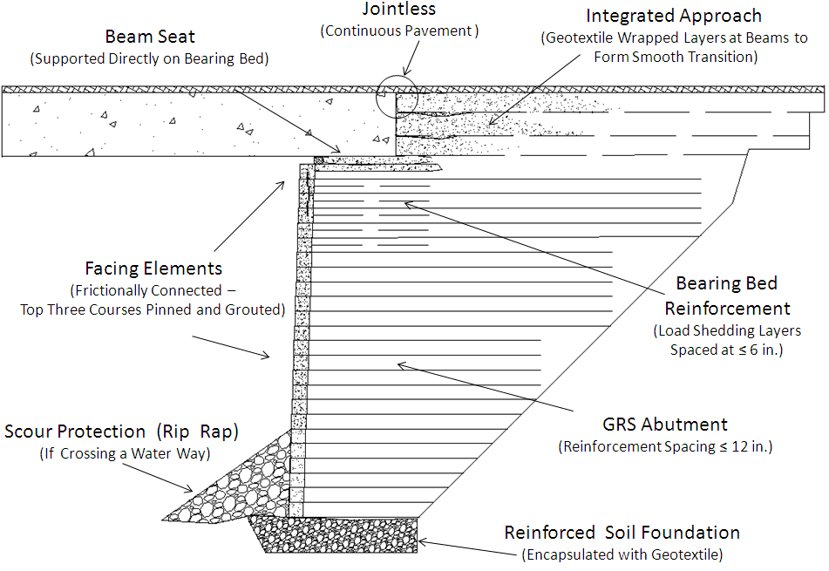
Bridge abutments

Slide 27
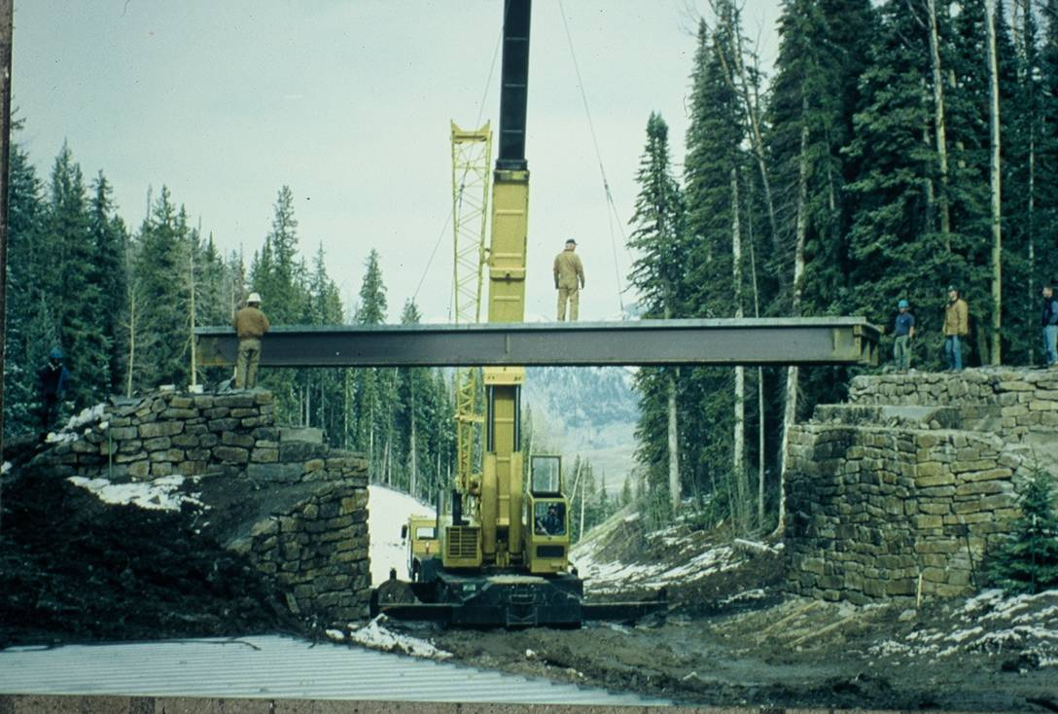
Bridge Abutment Construction
GRS Benefits
Reduced Construction Cost (25-60%)
Reduced Construction Time
Less Weather Dependent
Field Modified Design – Flexible
QA/QC Advantages

Slide 28
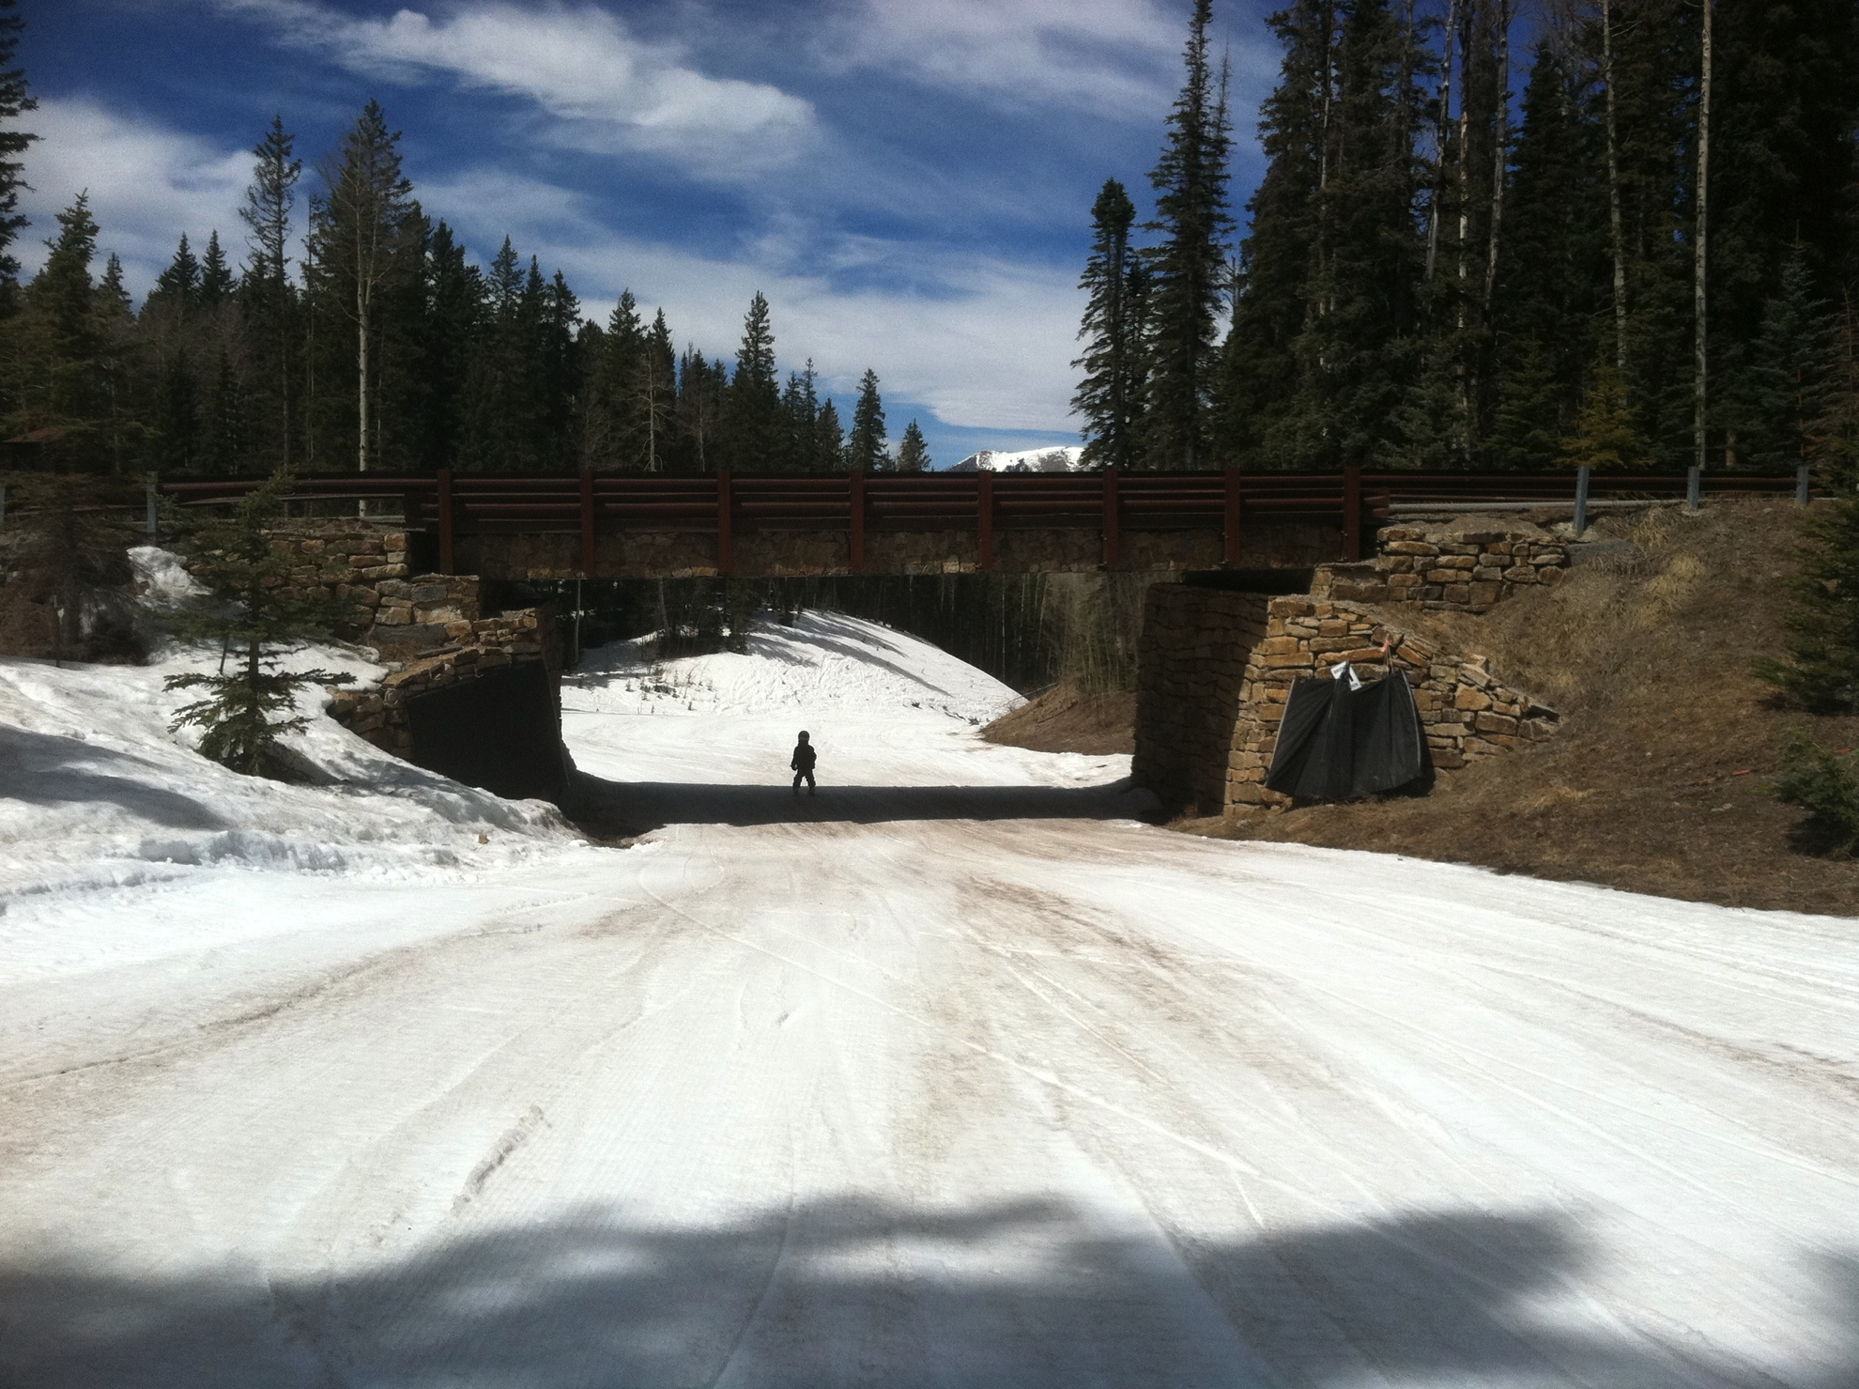

Slide 29
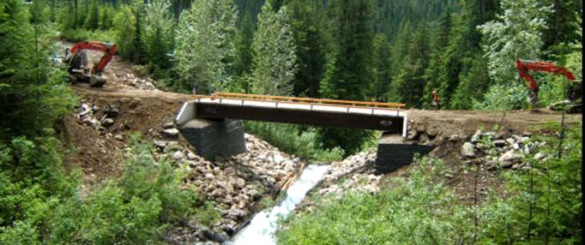

Slide 30
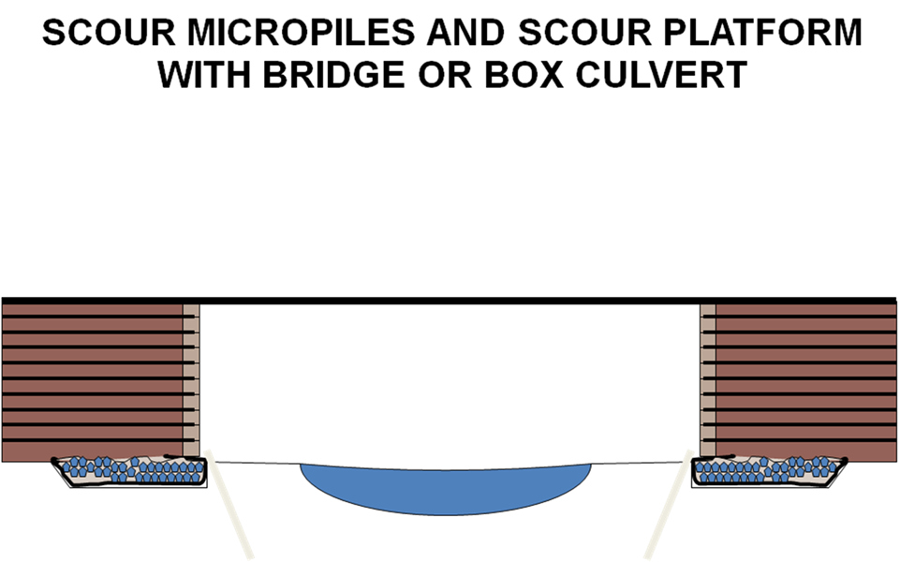

Slide 31
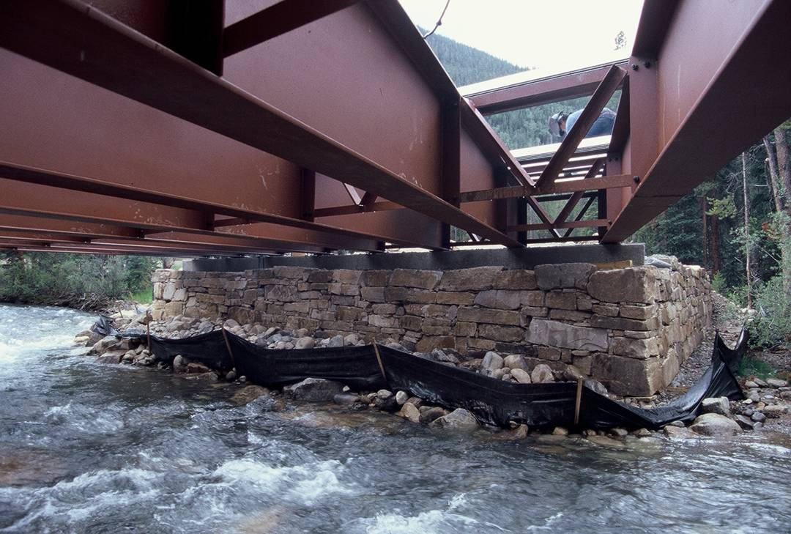

Slide 32
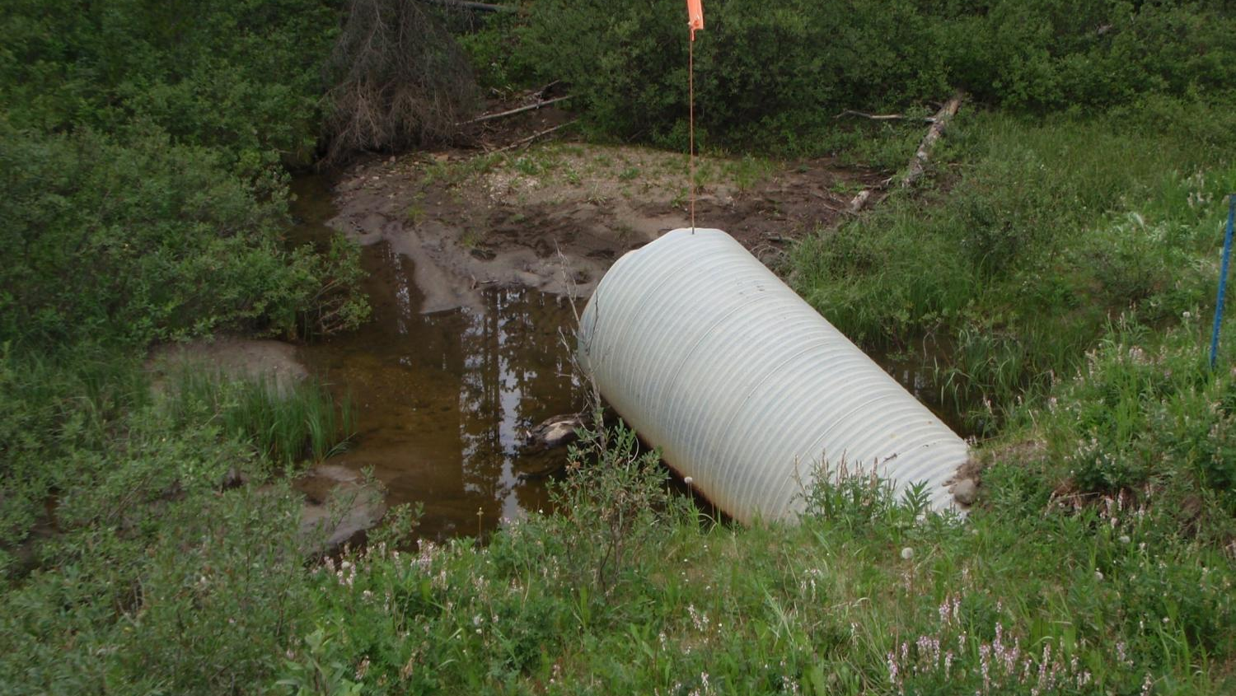
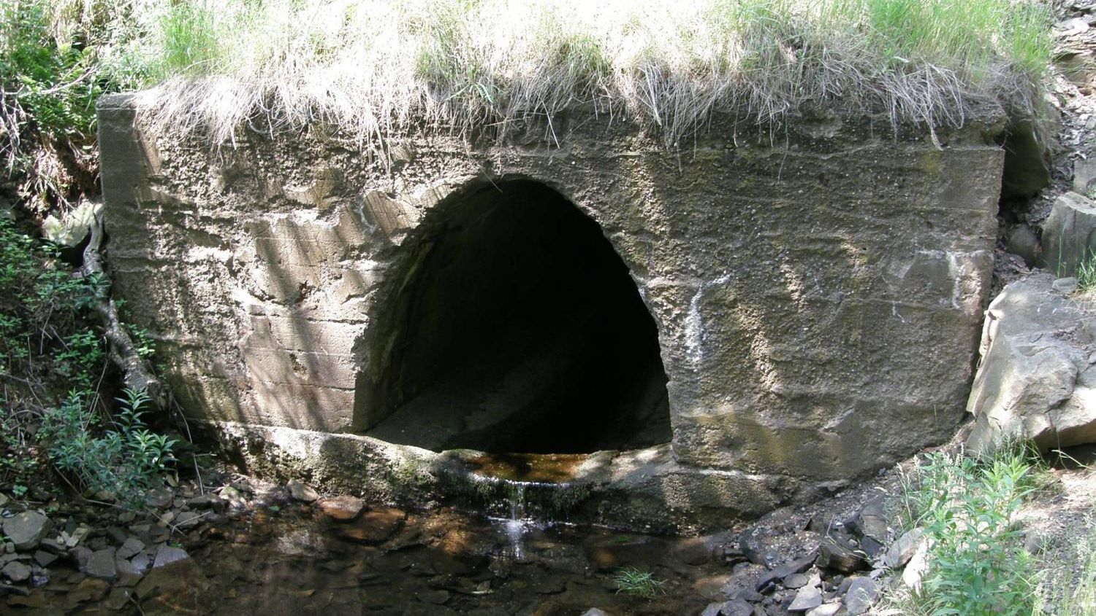
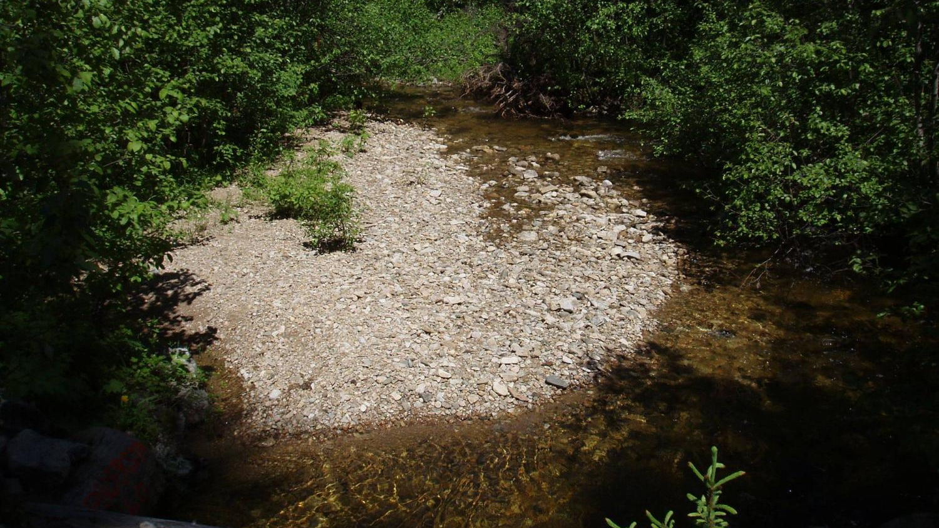
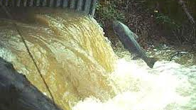
Constricted channels
Inlet Ponding
Hydraulic Uplift
High Velocity Flows
Scour
Interrupt Sediment Transport
Washout
Waterfalls
Barriers to Fish Passage

Slide 33
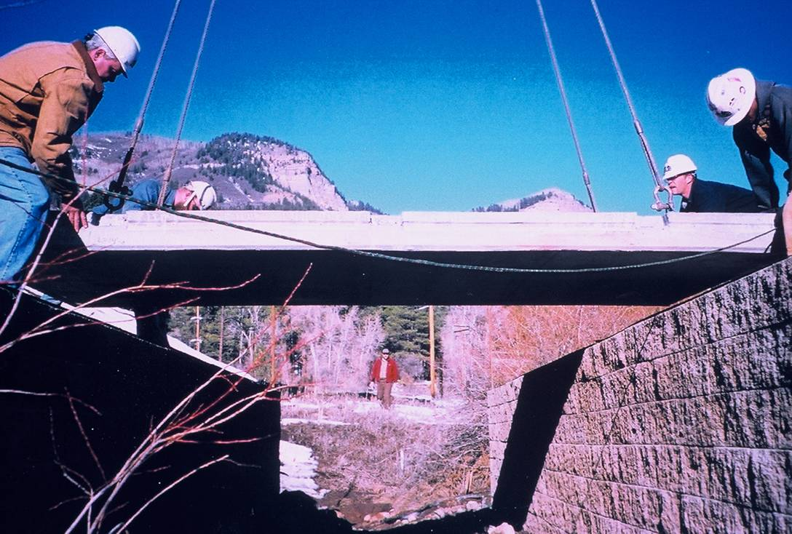
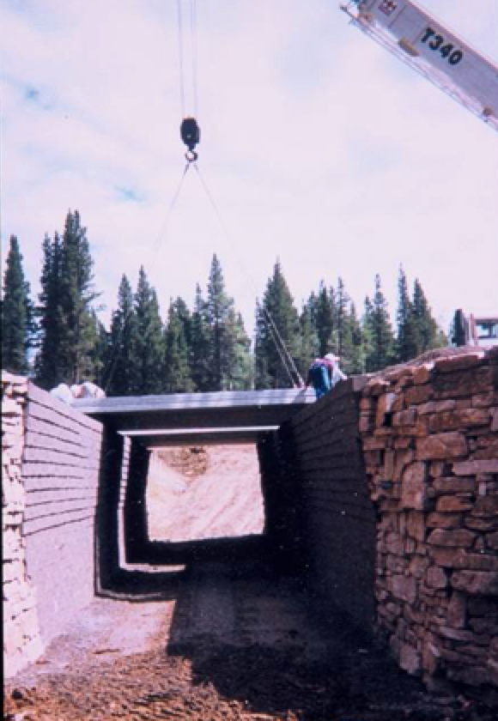
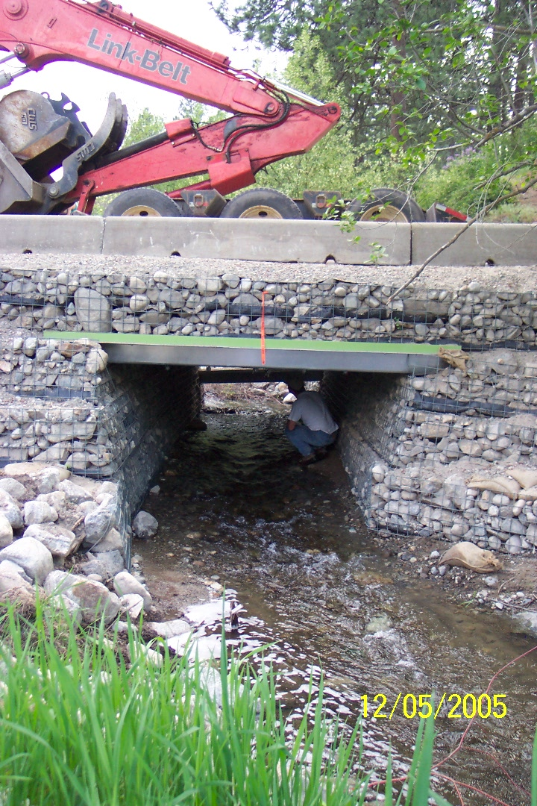
Box culverts
Higher flows while addressing many environmental concerns

Slide 34
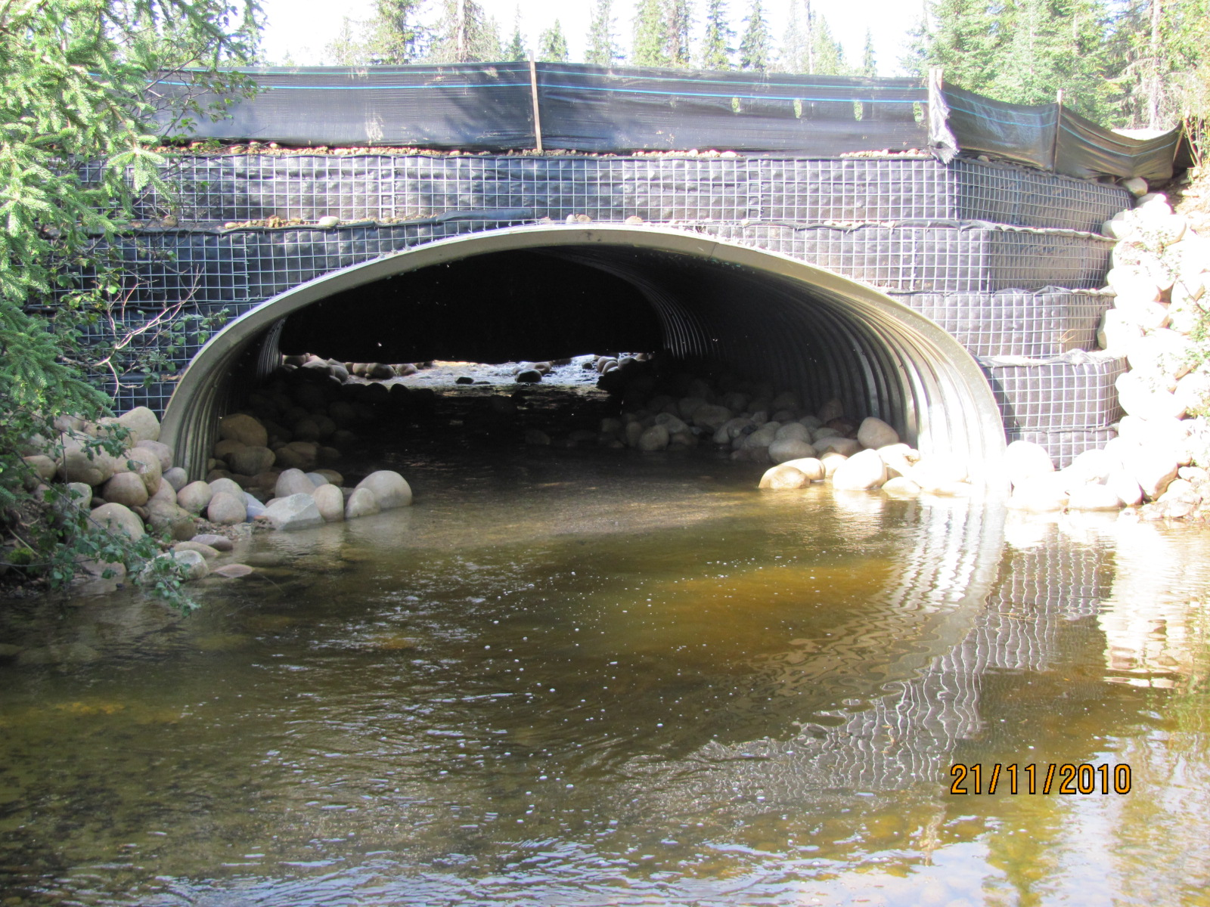
GRS ARCH

Slide 35
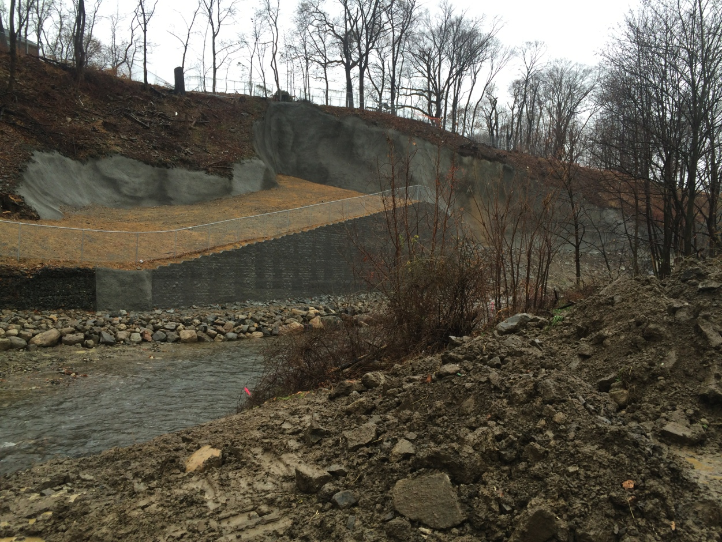
Stream Realignment

Slide 36
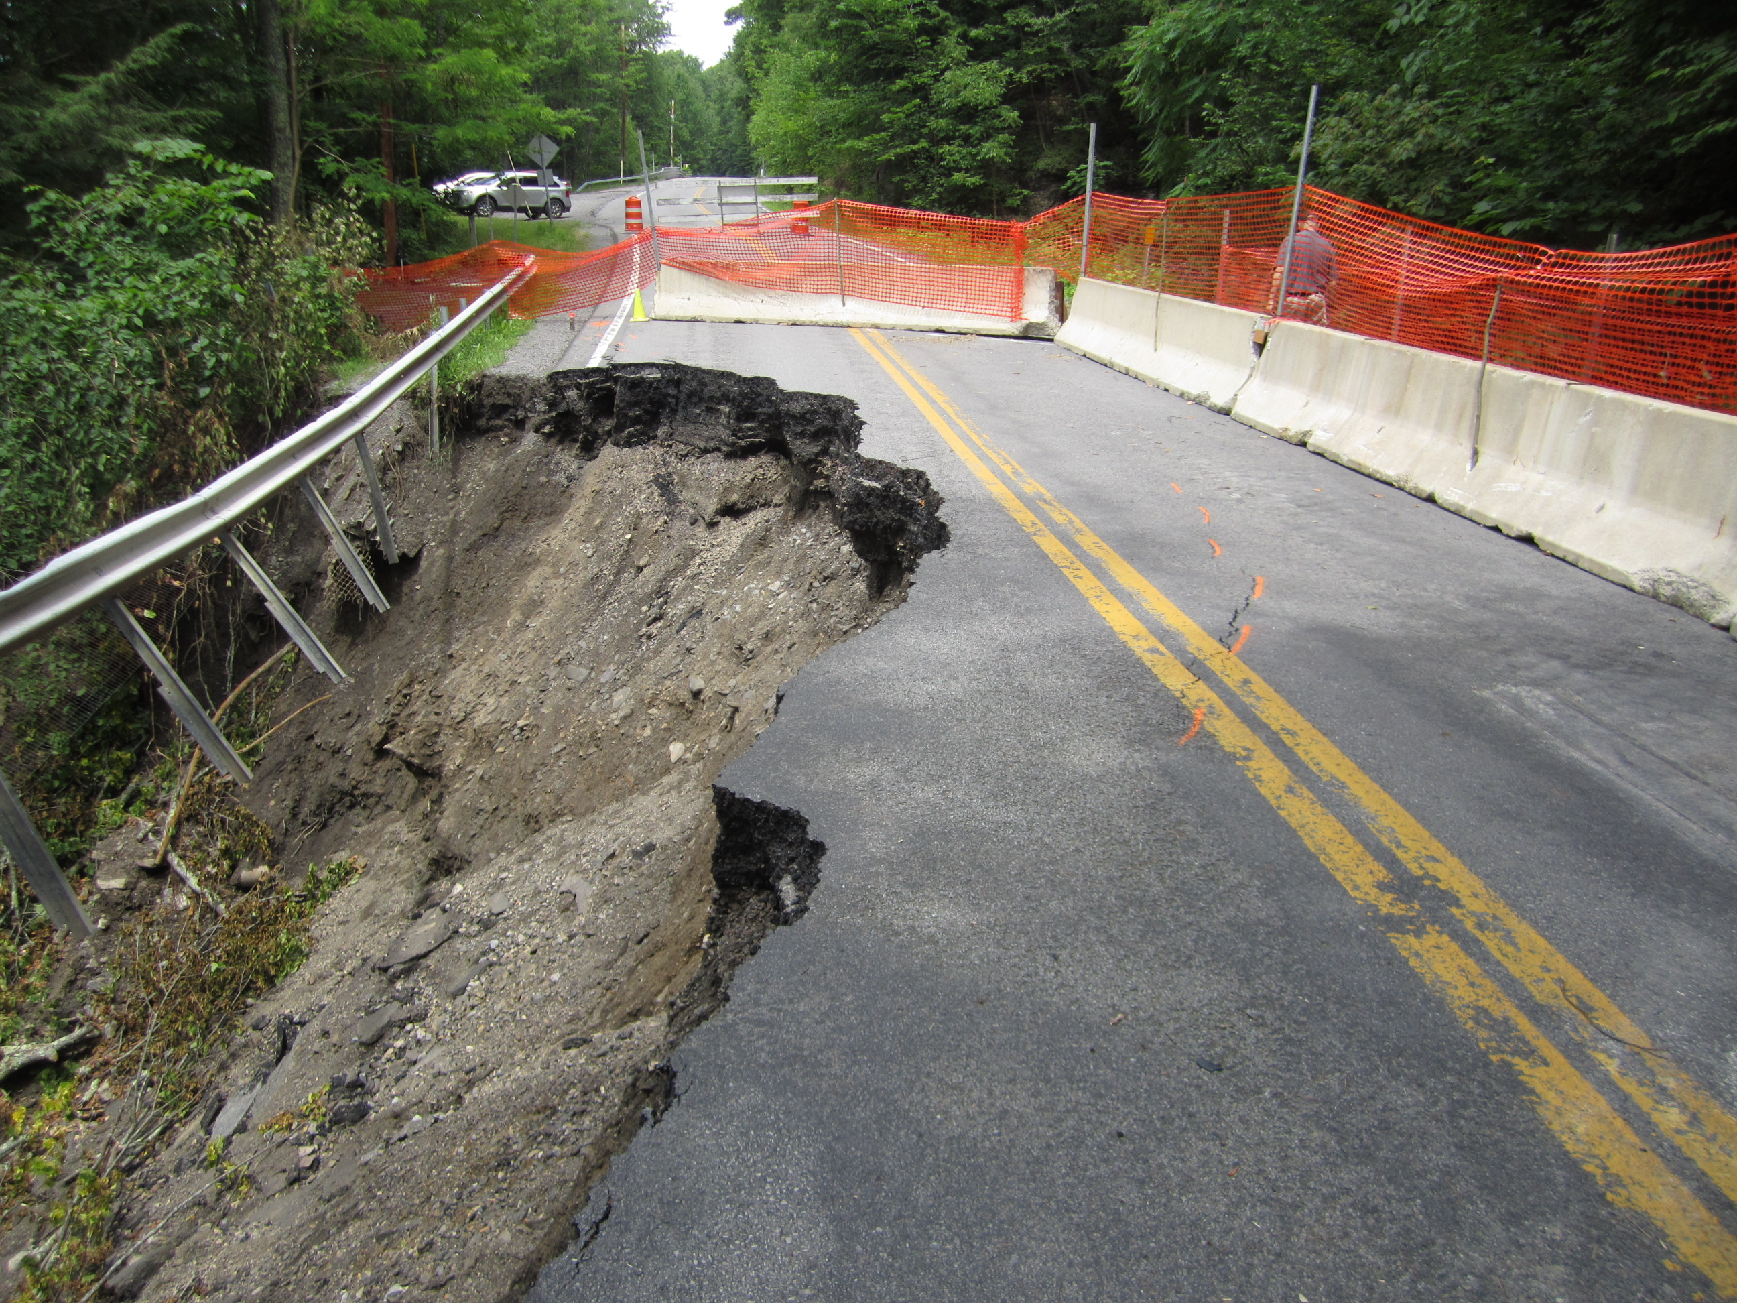
Shoulder Failure

Slide 37
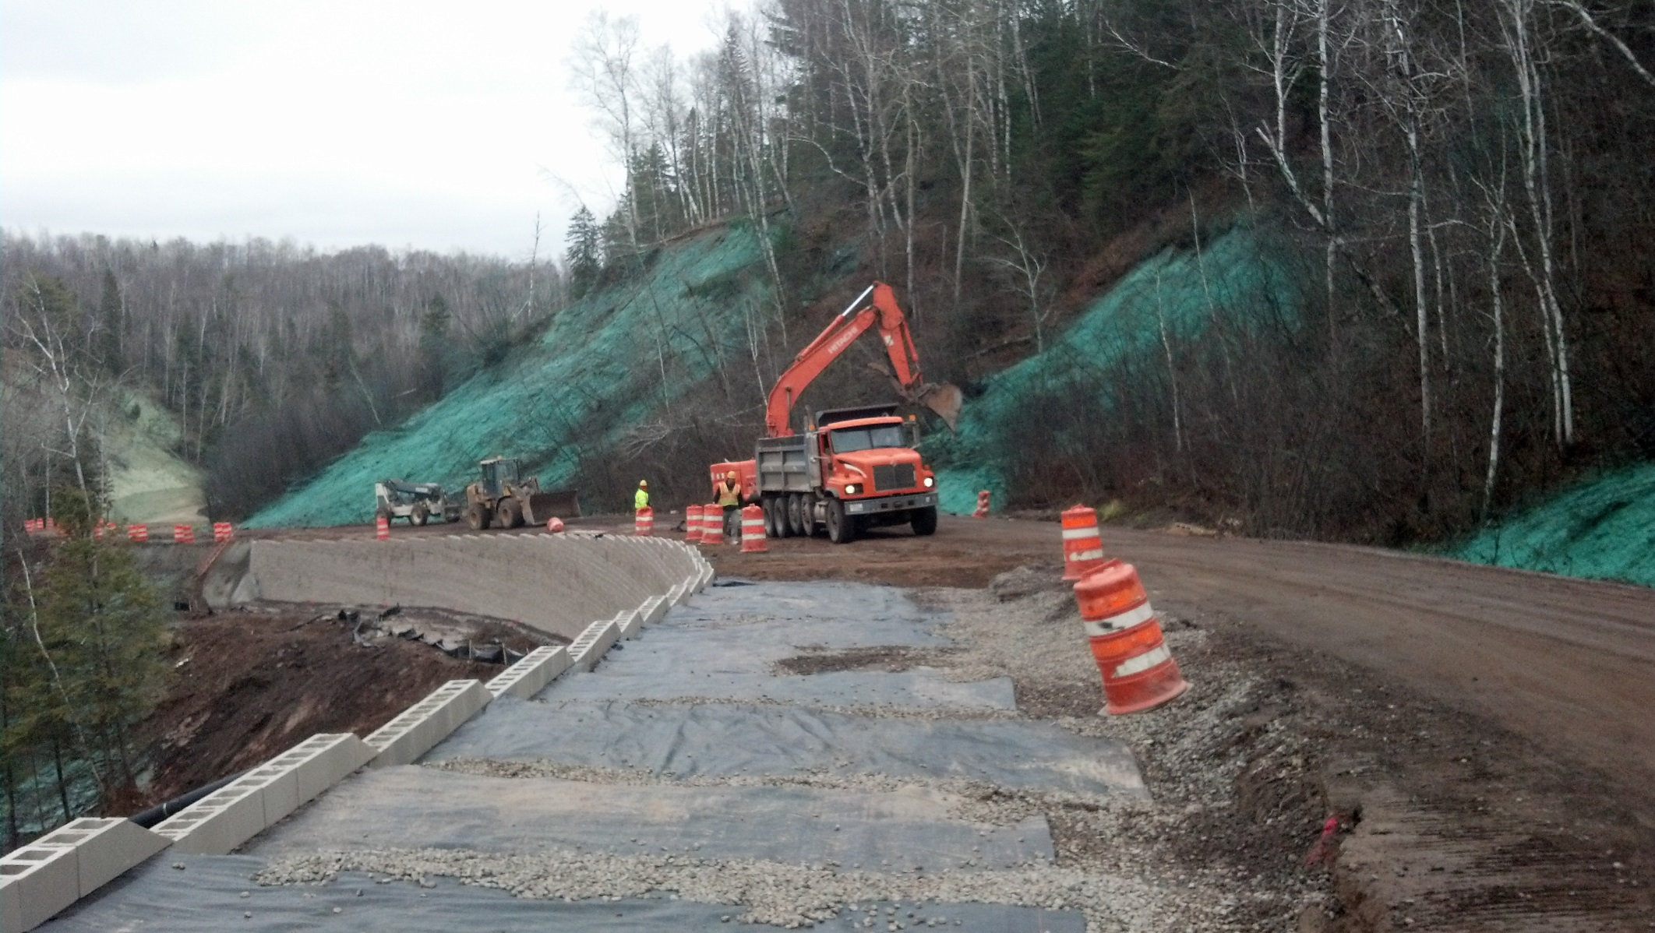
Complete Roadway reconstruction

Slide 38
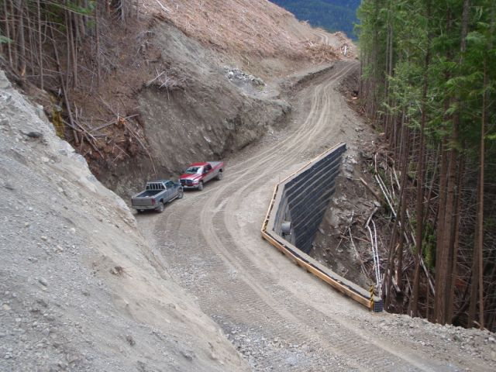
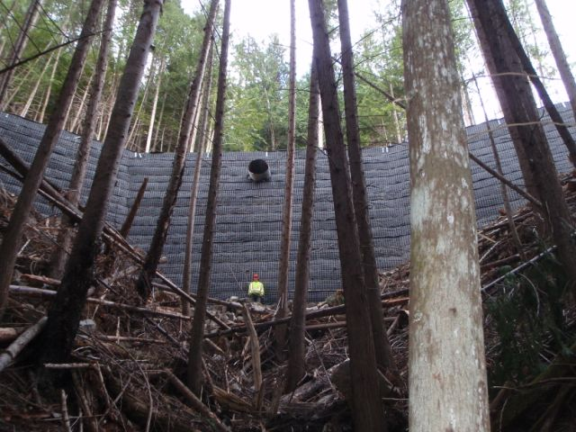
Remote access

Slide 39
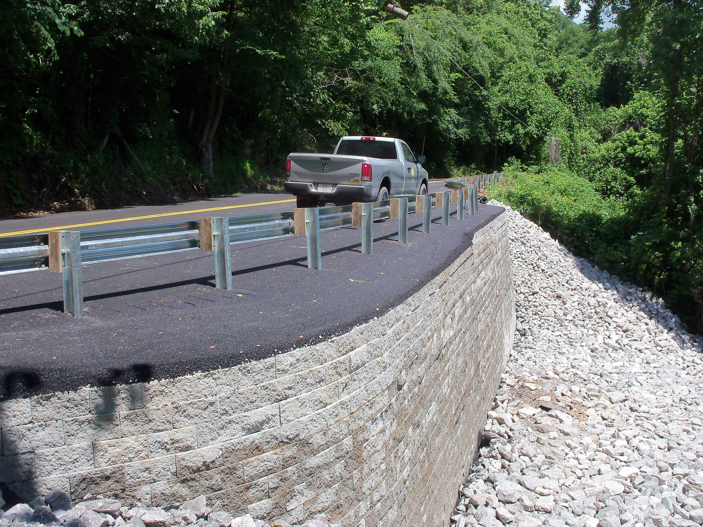
Guardrail & guiderail

Slide 40
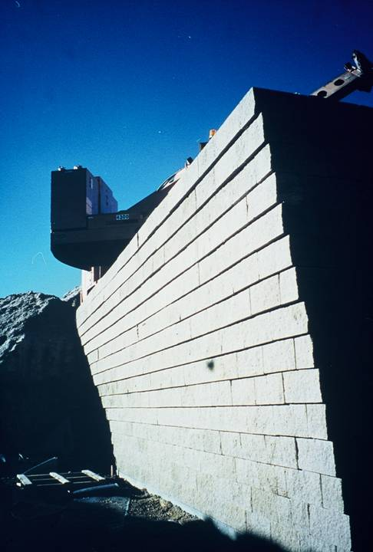
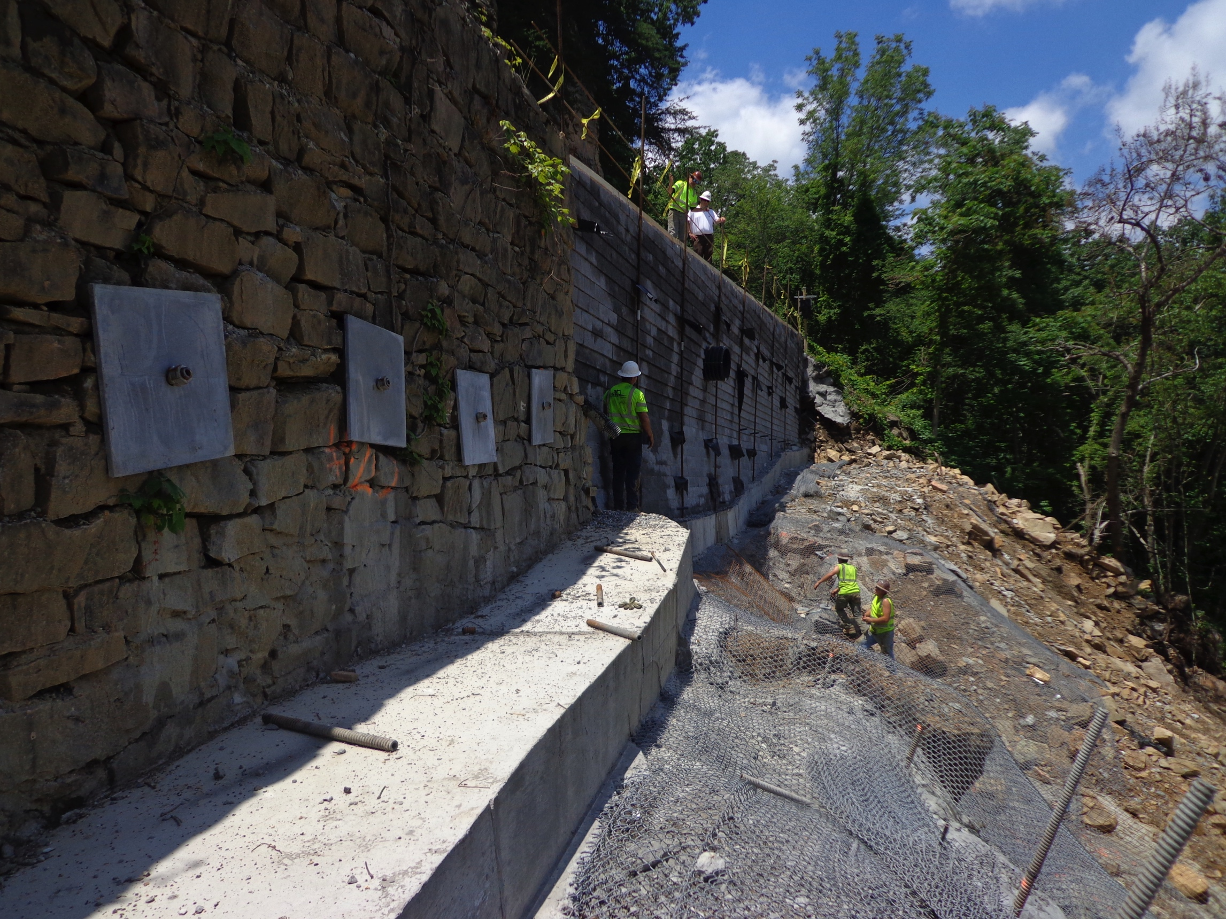
NEGATIVE BATTER

Slide 41
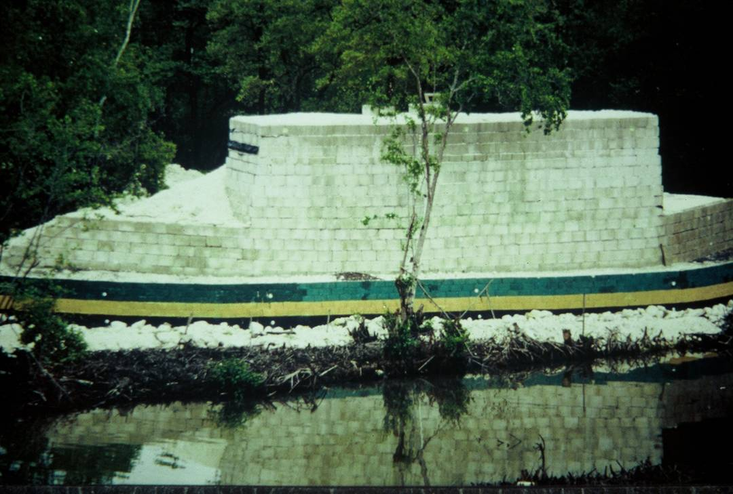
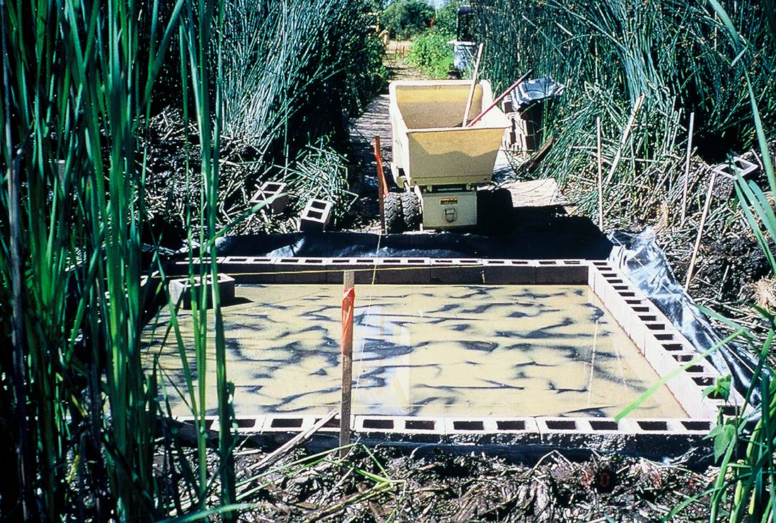
SETTLEMENT

Slide 42
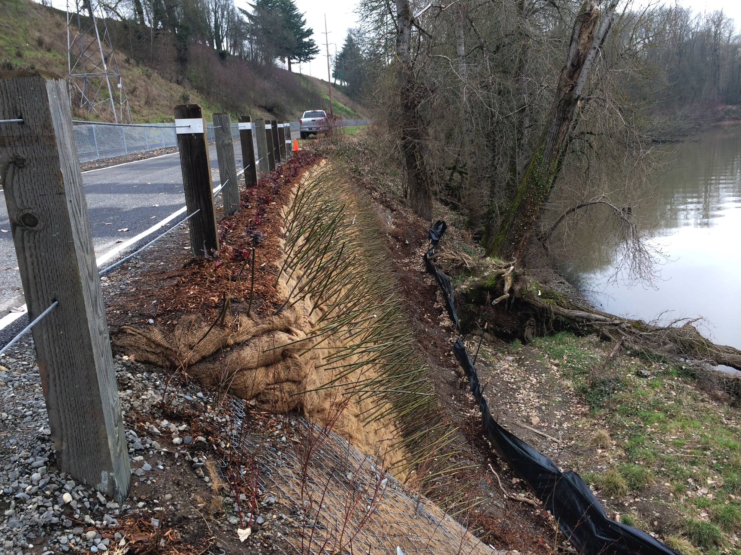
GREEN AESTHETICS

Slide 43
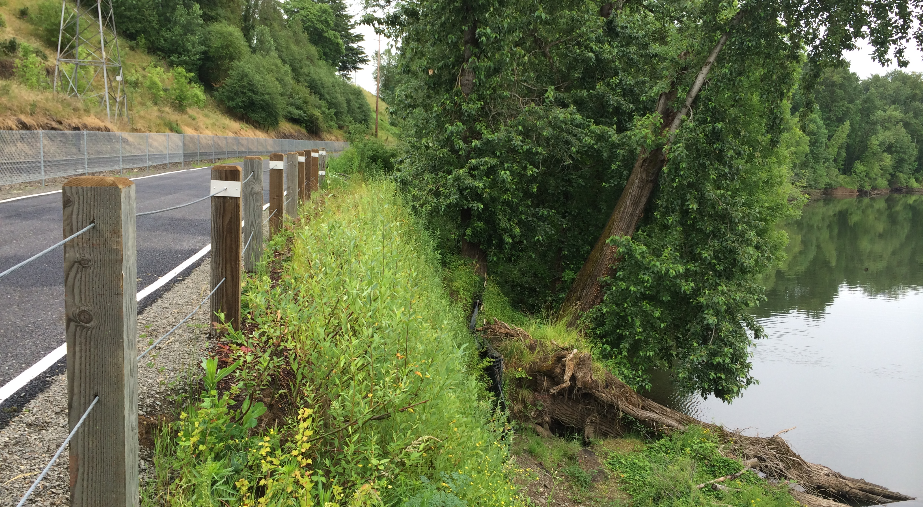
Where is it?

Slide 44
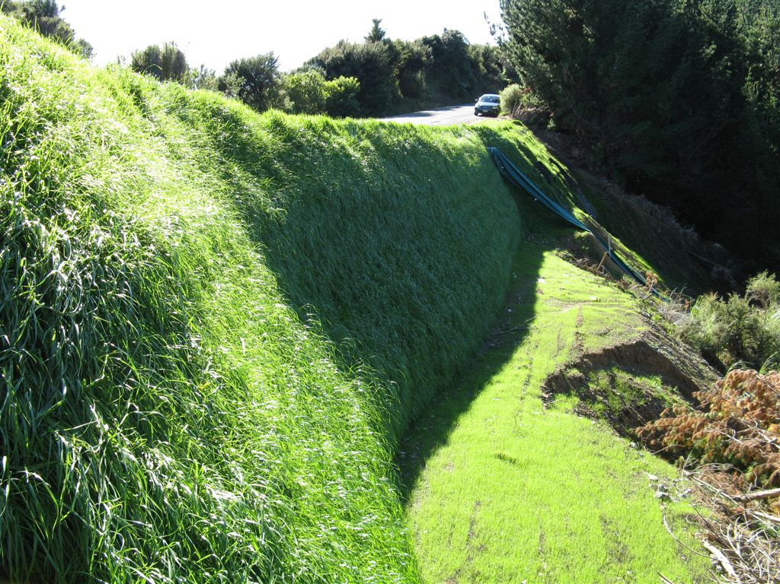
Vegetation Faced

Slide 45

Natural stone

Slide 46

NATURAL STONE

Slide 47

NATURAL STONE

Slide 48


COMBINATION OF BLOCK AND NATURAL STONE

Slide 49


BARRIERS

Slide 50


Slide 51

Impacted by 2700 cubic metre rockslide

Slide 52


Slide 53


Slide 54


Slide 55


Slide 56


Slide 57
CASE STUDY – Laurens County, GA

Slide 58
The Site Had a number of unique challenges
Bearing Capacity
  2,500 psf
  Clayey Sands & Silty Sands
Fine Sands/Silts = Scour Concern
Budget
Contract Delivery
  GSI Design Abutments
  Contech – Superstructure
  County Forces Build.

Slide 59


Georgia is ranked average in its bridge inventory

Slide 60

The existing bridges were in a state of disrepair

Slide 61

The existing bridges were in a state of disrepair

Slide 62


Scour

Slide 63

Scour micropiles ® prevent scour

Slide 64

Scour micropiles ® prevent scour
1 Day of Drilling Per Abutment

Slide 65

Drilled Soil Nails w/ hollow bars

Slide 66

GRS-IBS Bridges have survived floods
Mount Pleasant Rd. Huston Township, Clearfield County, Pa.

Slide 67

GRS-IBS Bridges have survived floods

Slide 68


Rip-rap position comparison study
Upstream Left
6/6/14
7/8/13

Slide 69


Scour micropiles ® & Rip-Rap

Slide 70

Bearing pressure – increase bridge footprint

Slide 71

FHWA’s publications - valuable insight
FHWA – No less than 8 Specific Tools for Engineers are available on the Every Day Counts website.

Slide 72
FHWA – Instrumented Bridges – settlement?
Majority of settlement occurs during dead loads & before open to traffic.

Slide 73
FHWA – Instrumented Bridges – settlement?
Many more bridges have been instrumented and results are consistent

Slide 74

Pumping??? No Problem!
GRS Construction inherently uses the benefits of geotextiles and granular fills to:
  Drain Saturated Soils
  Relieve Pore Pressures
  Re-establish Particle-Particle interaction

Slide 75

Sunshine Hill Bridge – Foundation Excavation

Slide 76

Sunshine Hill Bridge – Foundation Excavation

Slide 77

Remain calm, use the tools in your toolbox.
The combination of well drained, fractured-faced granular materials and geotextiles is highly effective.

Slide 78


Before and after – sunshine hill bridge

Slide 79

Back to laurens county, ga

Slide 80

Teaching The County Forces to Build
So Easy Detainees can do it!

Slide 81

Invest in the first course…Everything bears on it!

Slide 82

Production Rates Improve after 1st course

Slide 83

Smooth and compact by hand

Slide 84

Next compact w/ vibration

Slide 85
Production Rates Improve after 1st course

Slide 86

Concrete beam seats for steel superstructureS

Slide 87

PlanNED For Deflection of Superstructure

Slide 88

Almost open

Slide 89
Budget & Contract Delivery
Budget:
  Early Projections 40-50% savings.
Contract Delivery Methods:
  Empower the county to construct as much as possible
    Buy Materials
    Use County Forces
    Use County Labor Resources (Detainees)
Communicate!
  Simple Design & Construction doesn’t mean less communication
  Coordination between design and construction groups is essential.
Every Day Counts…. Remember this during design and specification
  Replace more bridges with less funds for safer roads for our families.

Slide 90

Thank you!! Questions??

